Slide 1
Immigration &
International Human Rights
Research Resources
Professor Heywood
11 September 2019

Slide 2
Our road map
US immigration law
Treatises, articles, & research guides
Statutes & regulations
Cases & decisions
Forms, manuals, & other practice aids
Statistics
State laws
Foreign law
International human rights law

Slide 3
Key words – search terms
Aliens
Deportation – United States
Emigration and immigration law – United States
Visas – United States

Slide 4
Taxonomy
An orderly & systematic classification
All research, especially legal research is based on it
Prime example in law: the West key number system
Research libraries use the LC taxonomy (call numbers)
All indexes & search databases have one
Use it!

Slide 5
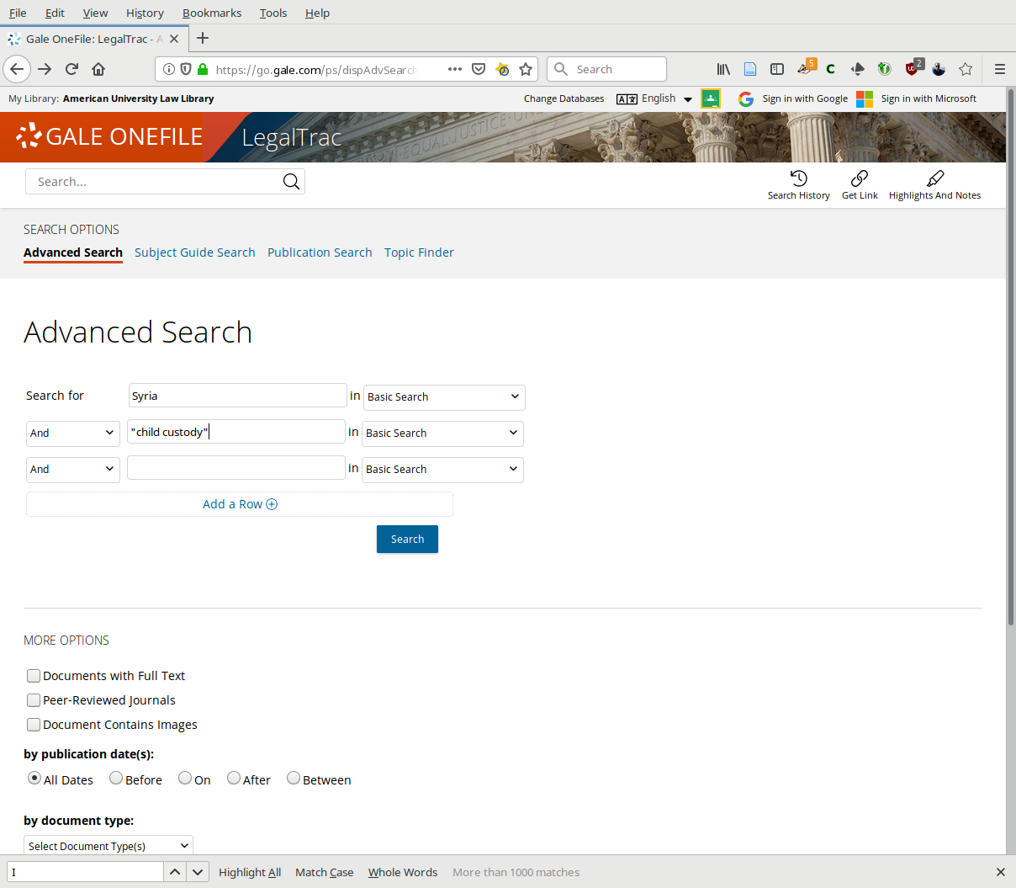
“One good source”

Slide 6
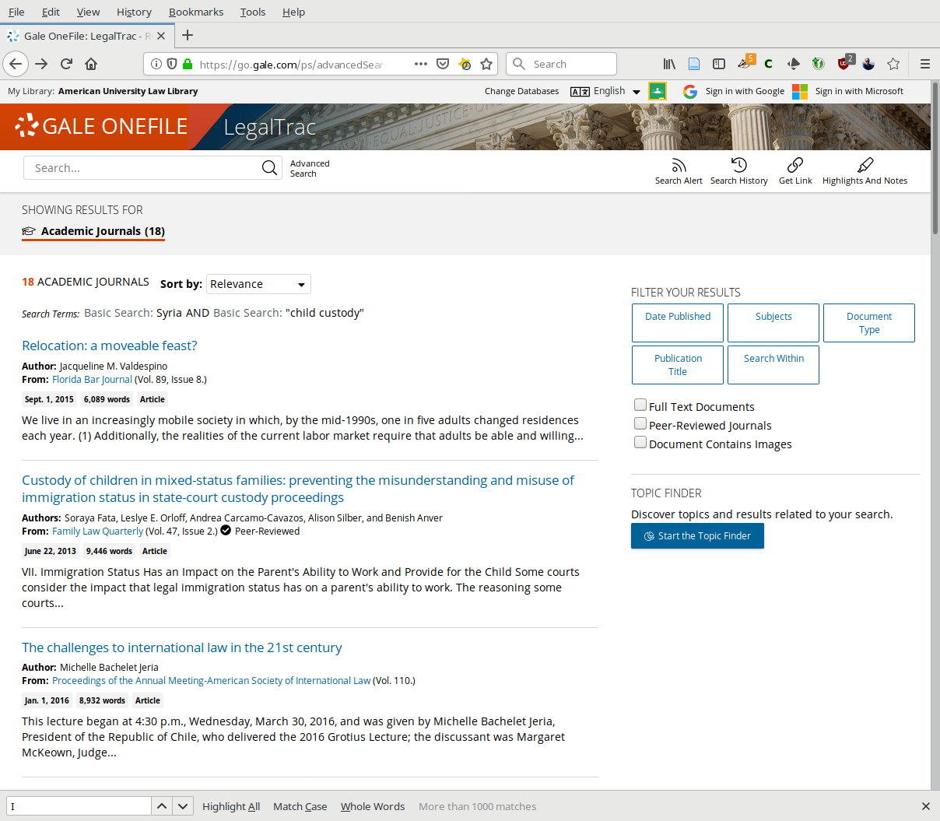
“One good source”

Slide 7
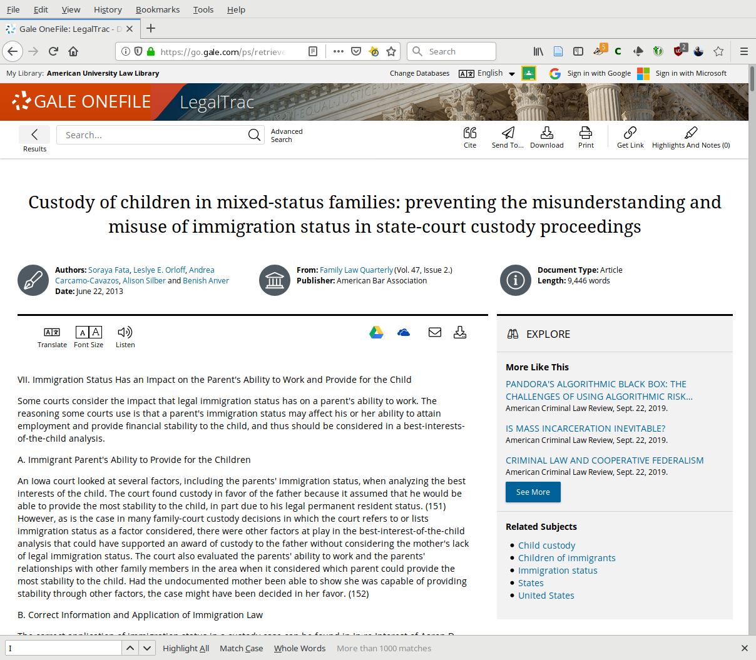
“One good source”

Slide 8
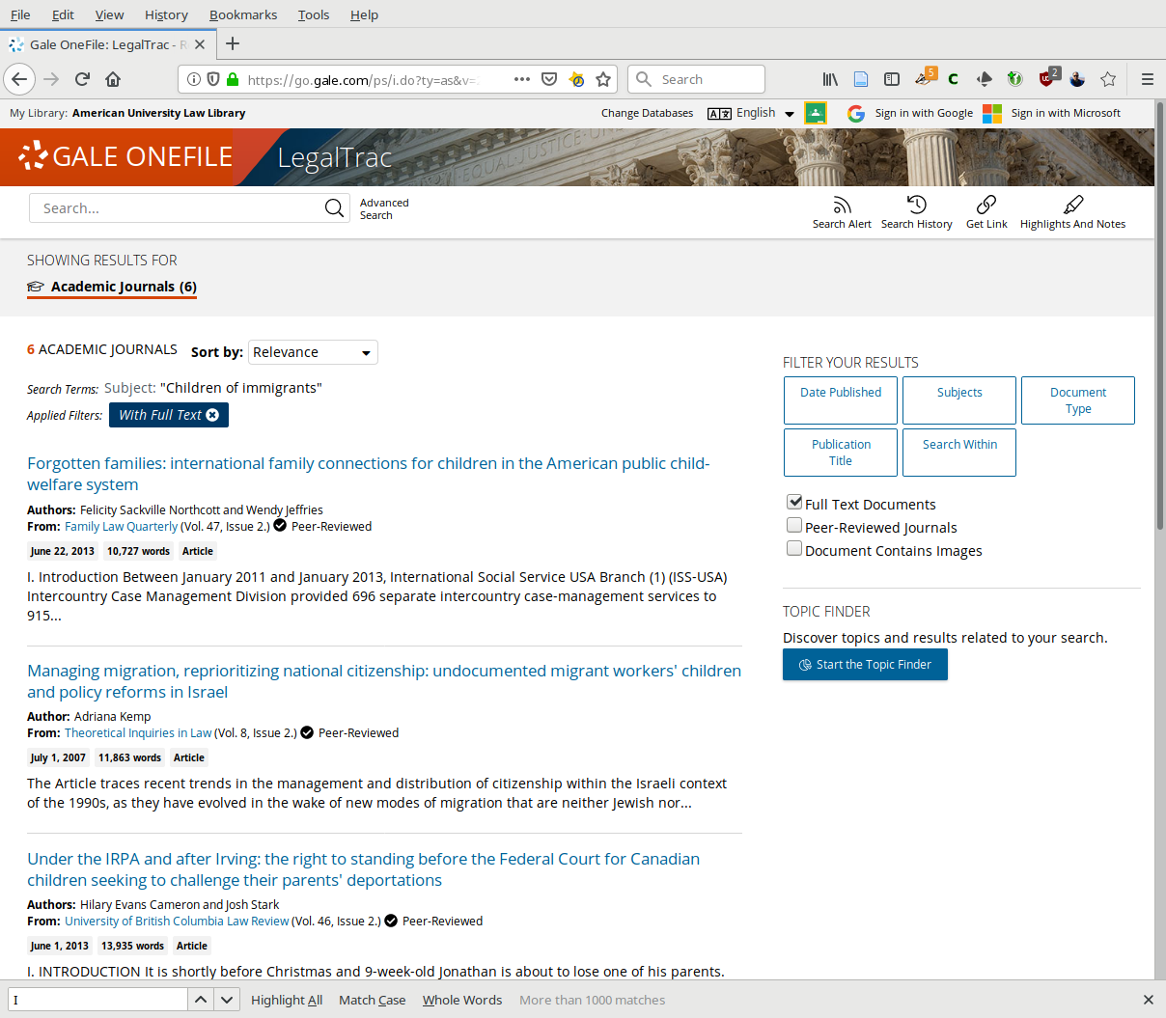
“One good source”

Slide 9
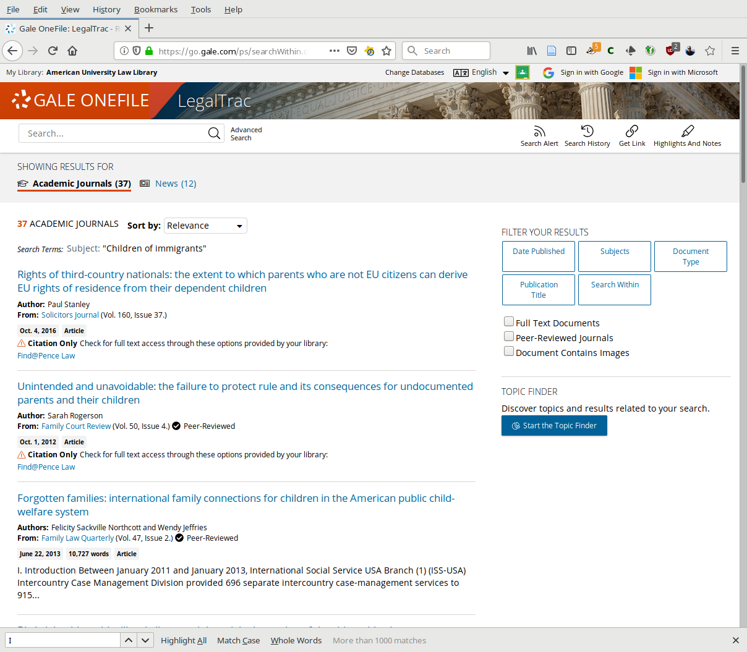
“One good source”

Slide 10
Treatises
Gordon, et al., Immigration Law & Procedure (Lexis)
Immigration Law Service, 2d (Westlaw)
Kurzban’s Immigration Law Sourcebook: A Comprehensive Outline and Reference Tool (AILALink)
Steel on Immigration, 2d ed. (Westlaw)

Slide 11
Treatises
Bender’s Immigration and Nationality Act Service (Lexis)
Fragomen on Immigration Fundamentals: A Guide to Law & Practice (Bloomberg)
Immigration Law and Crimes (under the auspices of the National Immigration Project of the National Lawyer’s Guild) (Westlaw)
Immigration Law and Defense (Westlaw)

Slide 12
Articles
2 “specialized law reviews” focus on immigration issues
Georgetown Imigration Law Journal (Westlaw, Lexis, HeinOnline)
Immigration Nationality Law Review (HeinOnline)
To locate articles on immigration topics use LegalTrac, Westlaw, and Lexis.

Slide 13
Research guides
Specialized Legal Research, Immigration Law, KF240 .S69 (Reserve)
Cornell’s Immigration Law Research Guide guides.library.cornell.edu/immigration_law
University of Maryland Immigration Clinic Research Guide law.umaryland.libguides.com/immigration_clinic
Yale’s Immigration Legal Services Resources library.law.yale.edu/clinics/immigration-legal-services
Westlaw/Lexis have subject specific sources in secondary source tabs/folders

Slide 14
Statutes
United States Code, Title 6
Chapter 1 – Homeland Security Organization
Subchapter IV – Directorate of Border, Maritime, & Transportation Security
Part B – United States Customs Service
Part D - Immigration Enforcement Functions
Part E – Citizenship and Immigration Services
Part F - General Immigration Provisions
United States Code, Title 8 – Aliens and Nationality
Immigration and Nationality Act
8 U.S.C. §§ 1101-1537

Slide 15
Access to statutes
GovInfo
Legal Information Institute (Cornell LII)
USCIS website
Westlaw
Bloomberg
Lexis
Fastcase
AILALink

Slide 16
Regulations
Code of Federal Regulations
Title 8 – Aliens and Nationality
Title 22 – Foreign Relations
eCFR & Govinfo
Cornell LII
Westlaw
Lexis
Fastcase
AILALink

Slide 17
Cases
Immigration cases – Westlaw/Lexis
AILALink
Fastcase
Bloomberg

Slide 18
Administrative decisions
DOJ – Board of Immigration Appeals (BIA)
Federal Immigration Administrative Decisions (including Board of Alien Certification Appeals decisions)
Lexis: Topic – Immigration – Federal Immigration Agency Decisions
Westlaw: Interpreter Releases – Text of BIA and a digest, 1923 to date
AILALink

Slide 19
Forms
Bender’s Immigration Litigation Forms – Lexis
Immigration Official Forms (more than 180 official forms) – Westlaw
AILALink

Slide 20
Manuals
Foreign Affairs Manual
Board of Immigration Appeals Practice Manual
Immigration Policy and Procedure Memorandum (USCIS) – Applications & Petitions
Other manuals
AILALink has them all
Westlaw & Lexis have most of them
Look in Gordon on Lexis

Slide 21
Current awareness
Newsletters:
Interpreter Releases (Westlaw)
Bender’s Immigration Bulletin (WCL Catalog)
Westlaw:
CQ Roll Call Washington Immigration Briefing
Immigration Briefings
Immigration Business News & Comment
The Hill: Immigration
Westlaw Immigration Daily Briefing

Slide 22
Blogs
Immigration Daily
www.ilw.com/immigrationdaily
Greg Siskind on Immigration Law & Policy
blog.ilw.com/gregsiskind
ImmigrationProfBlog
lawprofessors.typepad.com/immigration
Blawg Directory, the ABA directory of law blogs:
www.abajournal.com/blawgs/topic/immigration+law

Slide 23
Legislative updates
Westlaw – Immigration Proposed & Enacted Legislation
Westlaw – Immigration News
Journals, Magazines, Newsletters, Newspapers, Transcripts, and Wire Services

Slide 24
Federal agencies
U. S. Department of Homeland Security (DHS) (parent agency that oversees three major immigration agencies)
USCIS - www.uscis.gov - forms, faqs, laws (current and historical) and regulations
ICE - www.ice.gov - foreign students – detention portal information
CBP - www.cbp.gov - border security and travel information/newsroom

Slide 25
Federal agencies
EOIR - www.justice.gov/eoir - links to immigration courts and link to Immigration Court Practice Manual
Department of State - www.state.gov - links to laws, policies, and regulations – embassy and consulate directories and visa services.
Department of Labor - www.dol.gov - Maintains O*Net Online (www.onetonline.org) – occupational descriptions for immigration petitions – labor certification and immigration

Slide 26
Organizations
National Immigration Law Center
American Immigration Lawyers Association - www.aila.org
Link to AILALink – ailalink.aila.org (you must access through our A-Z list if you are off-campus)

Slide 27
Statistics
Syracuse University - TRAC - covers felonies and deportation, border protection, criminal convictions and prosecutions, criminal enforcement, DHS enforcement priorities, immigration courts, immigration inspections, and related topics
trac.syr.edu
DHS – Immigration Statistics -
www.dhs.gov/immigration-statistics
Also on Lexis – DHS Yearbook Immigration Statistics

Slide 28
State laws
Lexis – Immigration State Law; State Laws pending
National Conference of State Legislatures – Immigration and Immigrants
www.ncsl.org/research/immigration/state-laws-related-to-immigration-and-immigrants.aspx

Slide 29
Other useful stuff
State Department – Country Reports on Human Rights Practices
Lexis: Home > Administrative Materials > International Law > Country Reports on Human Rights Practices
Westlaw: Home > Administrative Decisions & Guidance > Federal Administrative Decisions & Guidance > Department of State > U.S. Department of State - Country Reports on Human Rights Practices
Also available in HeinOnline & ProQuest Congressional as Committee Prints
Visa Bulletin – wait times for visa backlogs
travel.state.gov/content/travel/en/legal/visa-law0/visa-bulletin.html

Slide 30
Foreign law
Foreign Law Guide Laws by Subject Citizenship, Emigration, Immigration & Nationality
vLex/Justis
WorldLII
GlobaLex
World Law Guide
LegislationOnline (OSCE)
Global-Regulation

Slide 31
International human rights law
Treaty research
Multilateral
Bilateral
Custom & general principles
Publicists
Judicial decisions

Slide 32
International human rights law sources
My website: https://internationalcourts.net/research
U.N. High Commissioner for Refugees (UNHCR) RefWorld
European Court of Human Rights (HUDOC)
European Union (Curia)
Inter-American HR System
UN Treaty Body databases
ICC legal tools database

Slide 33
John Quentin Heywood
heywood@wcl.american.edu
202.274.4329
Office: N216

