Slide 1
international legal research
john quentin heywood
7 March 2019

Slide 2
all of international legal research in 45 minutes…
yeah. right.
not gonna happen
instead, we will take a quick tour of the high points & then focus on anything you want to know more about
  one topic already requested was space law, so we will do that

Slide 3
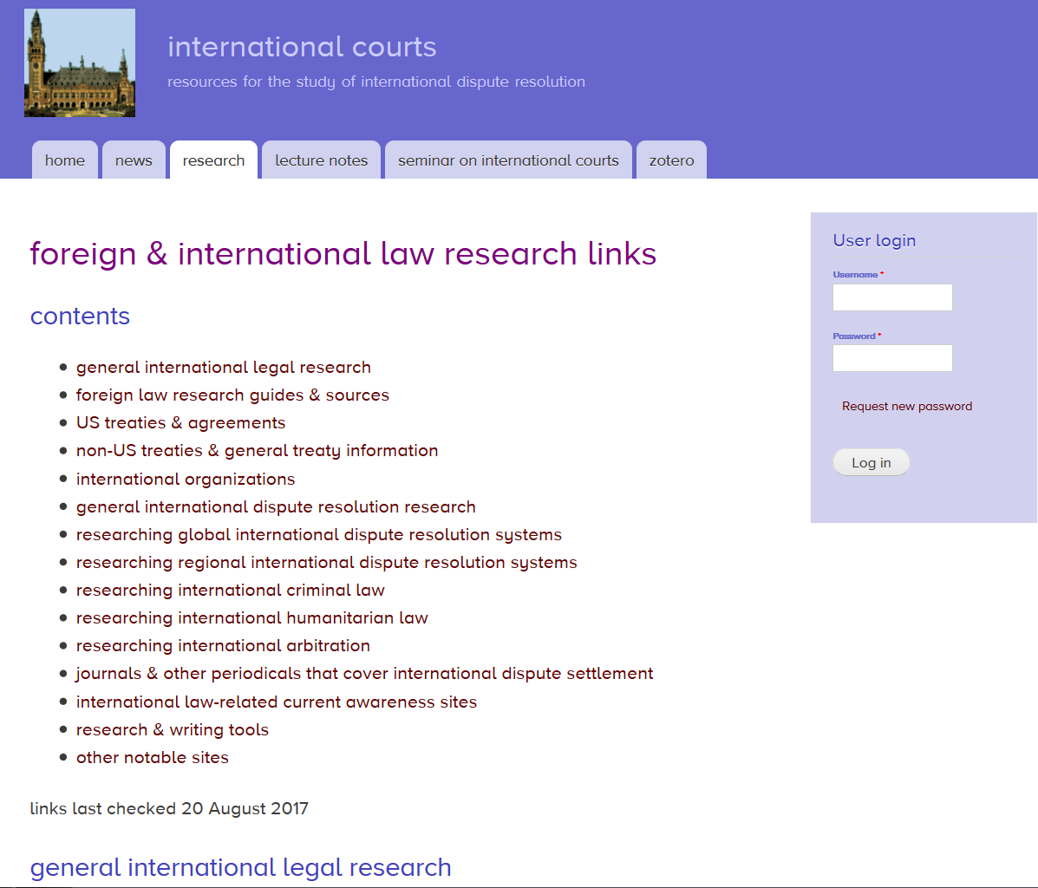
a place to start
these are the links I use every day
internationalcourts.net
the WCL proxy server links are built-in

Slide 4
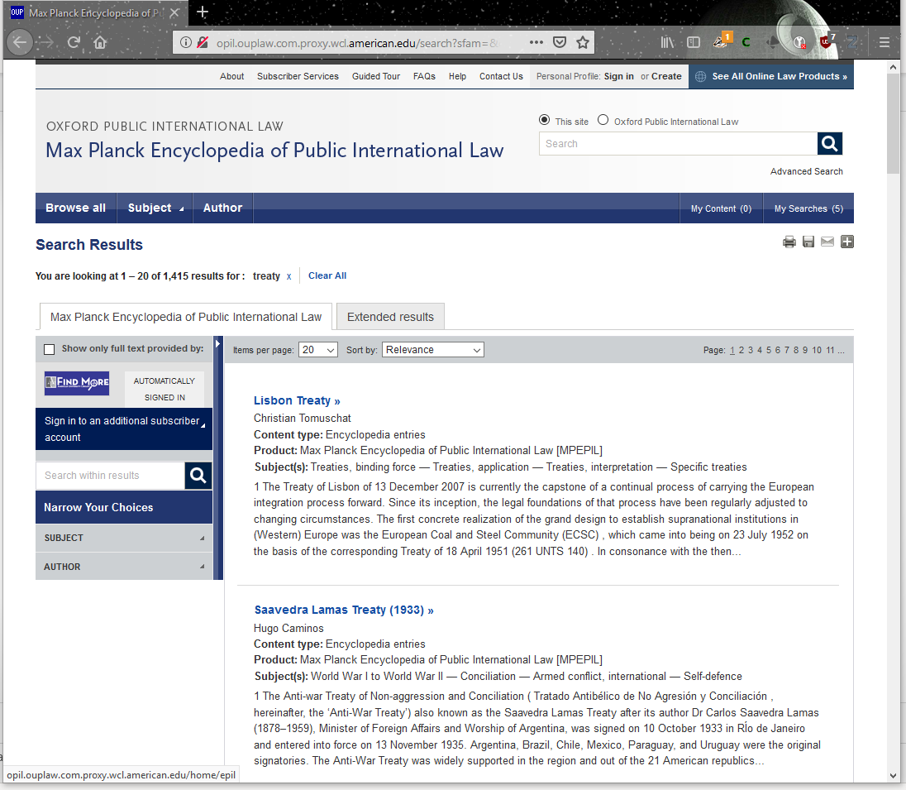
a favorite resource
Max Planck Encyclopedia of International Law
  great explanation of 100s of international law topics
  each entry has a bibliography

Slide 5
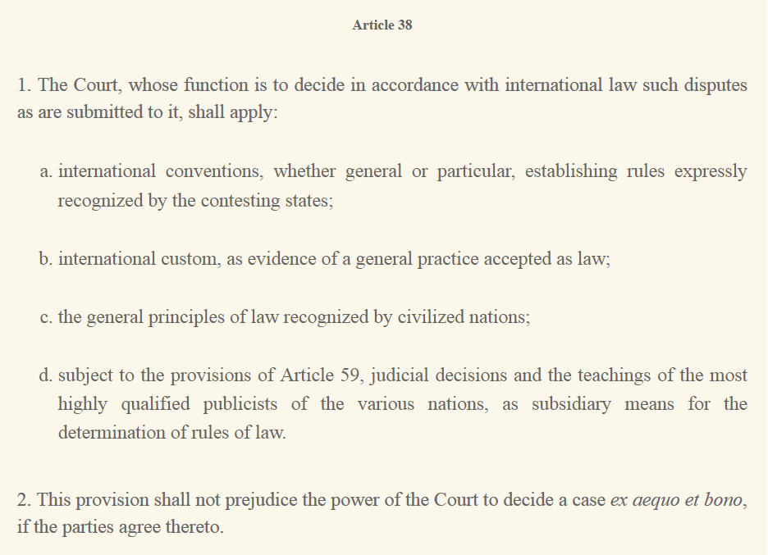
what is international law?
ICJ Statute art. 38
primary sources:
  treaties
  custom
  general principles of law

Slide 6
what is international law?
ICJ Statute art. 38
secondary sources:
  judicial opinions
  teachings of the most highly qualified publicists

Slide 7
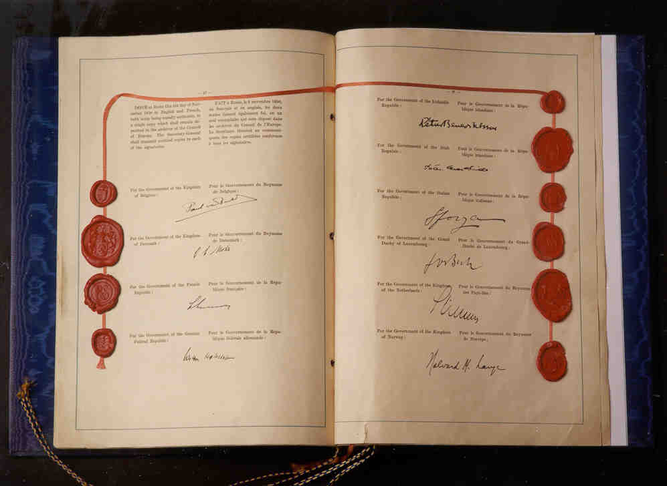
let’s talk about treaties
most important thing about a treaty:
  intent to be bound
  without that intent, just a political commitment

Slide 8
let’s talk about treaties
2 basic kinds
  bilateral
  multilateral
2 other basic kinds
  regular
  simplified

Slide 9

bilateral v. multilateral
bilateral treaties are really basic
  between 2 entities, usually nation-states
  must be signed & ratified

Slide 10
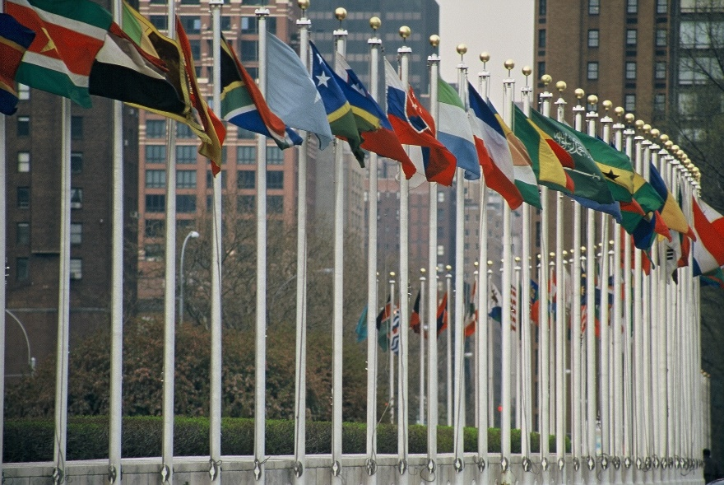
bilateral v. multilateral
multilateral treaties are more complex
  between 3 or more entities
    nation-states
    international organizations
  must be signed & ratified
  depository needed

Slide 11
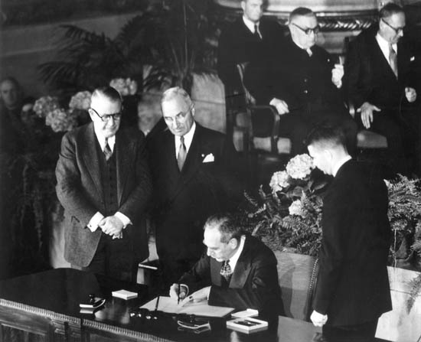
regular v. simplified
regular treaties are what you think
in the US
  diplomats negotiate
  President signs
  Senate gives advice & consent
  President ratifies

Slide 12
regular v. simplified
other countries have a similar process for regular treaties
  executive negotiates & signs
  legislature ratifies

Slide 13
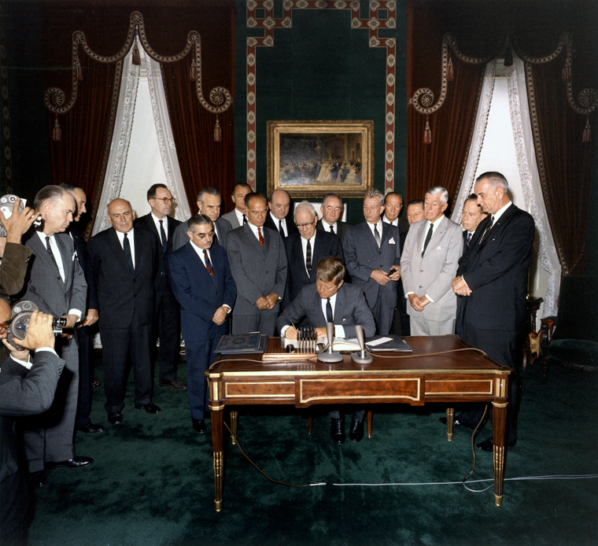
regular v. simplified
simplified treaties
we call them
  executive agreements
just need to be signed by parties
they are binding obligations
  unlike political committments

Slide 14
regular v. simplified
simplified treaties can be:
  formal written agreements
  exchanges of notes
  exchanges of signals (flags, etc.)

Slide 15
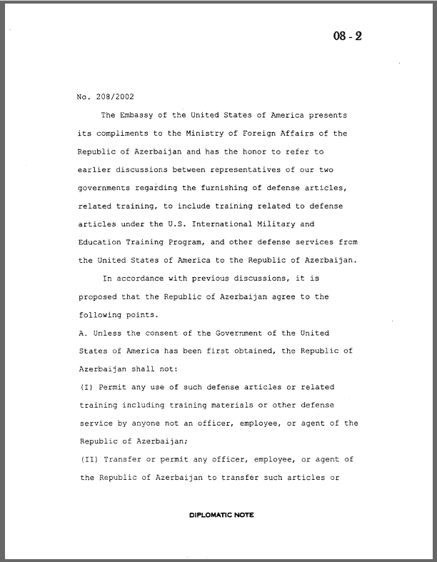
regular v. simplified
simplified treaties
let’s take a look at one

Slide 16
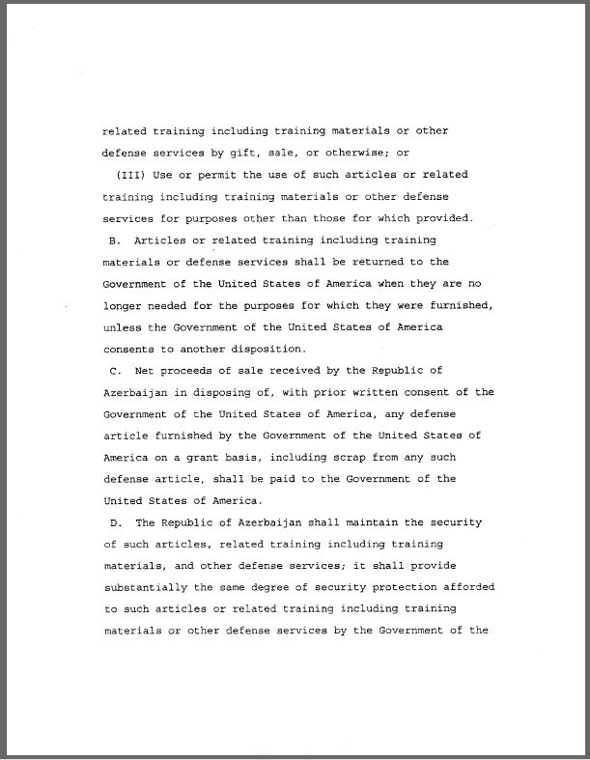
regular v. simplified
simplified treaties
let’s take a look at one

Slide 17
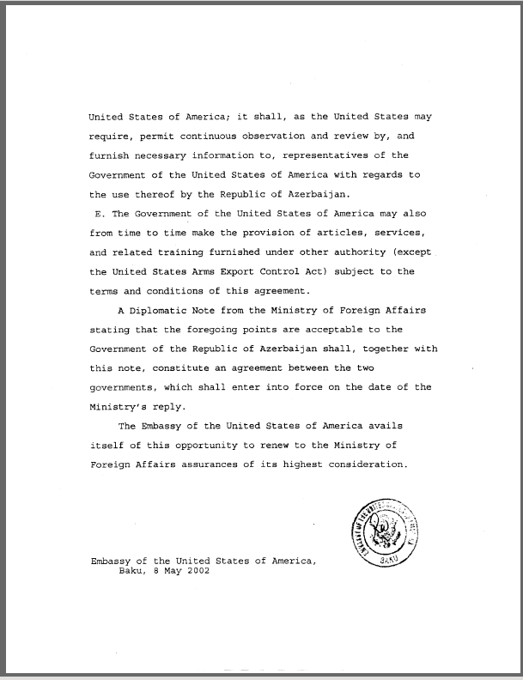
regular v. simplified
simplified treaties
let’s take a look at one

Slide 18
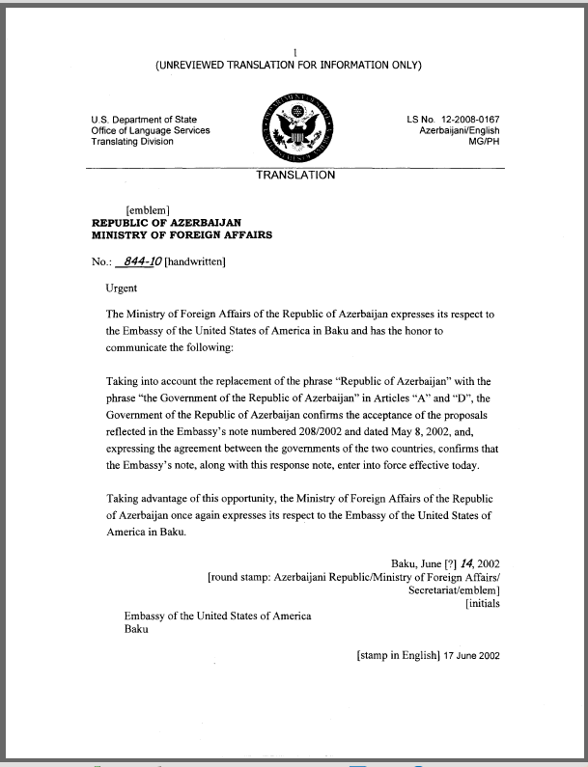
regular v. simplified
simplified treaties
let’s take a look at one

Slide 19

US executive agreements
we divide them into 3 types:
  sole executive agreements
  treaty-based executive agreements
  congressional-executive agreements

Slide 20
US executive agreements
sole executive agreements:
  recognize foreign governments
  armistice/cease-fire
  settle claims with foreign governments
  treaty term agreement

Slide 21
US executive agreements
treaty-based executive agreements:
  SOFAs for NATO
  scientific detail in environmental treaties
  details about treaty implementation

Slide 22
US executive agreements
congressional-executive agreements:
  vast majority
  all trade agreements
    NAFTA/USMCA
    WTO/GATT
    FTAs

Slide 23
US executive agreements
congressional-executive agreements:
  must pass both houses
  President must sign or have veto overridden

Slide 24
so now that we know what they are, how do we find them?

Slide 25
good question

Slide 26
an important caveat
this presentation assumes you need to find things for an academic purpose, not for litigation
research for litigation is much more complex
  the best evidence rule
  if a US agreement, you must use the best official source
  not as easy as you would think
  for non-US agreements, you need the judge to allow your source

Slide 27
first question
do I have a cite?
yes…
  this is the easiest
  ask a librarian if you don’t recognize the sources in the citation
  UNTS or LNTS
  OAS, EU, COE, or AU
  UST, Stat., TIAS, EAS, TS
no…
  read on

Slide 28
second question
is the US a party?
yes…
  great. use the US treaty tools
no…
  use UN tools
  use the treaty tools of states party
  use treaty indexes
  use google for a cite

Slide 29
third question
is the treaty in force?
yes…
  use indexes like US Treaties in Force
not yet…
  find the sponsors & look at their resources
  use google
not any longer…
  use historical tools

Slide 30
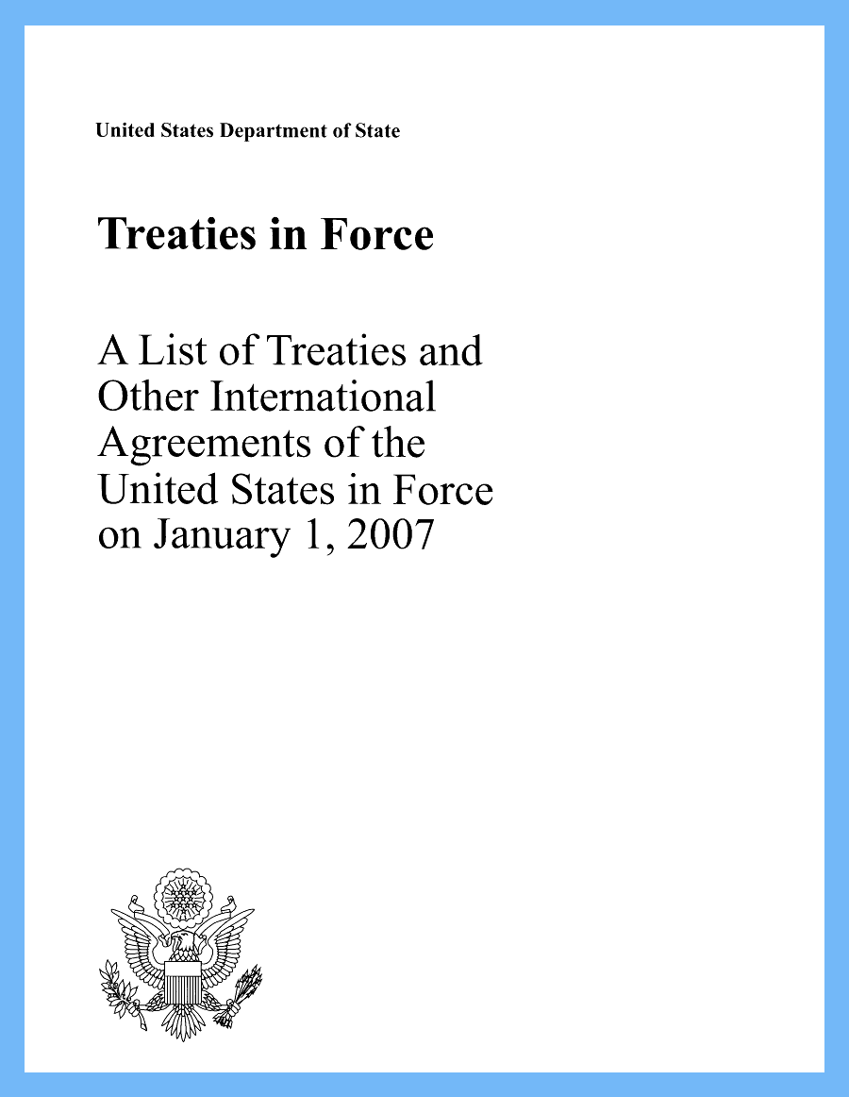
US treaty tools
US Treaties in Force
State Dept website
Trade Rep website
HeinOnline US Treaties & Agreements Library

Slide 31
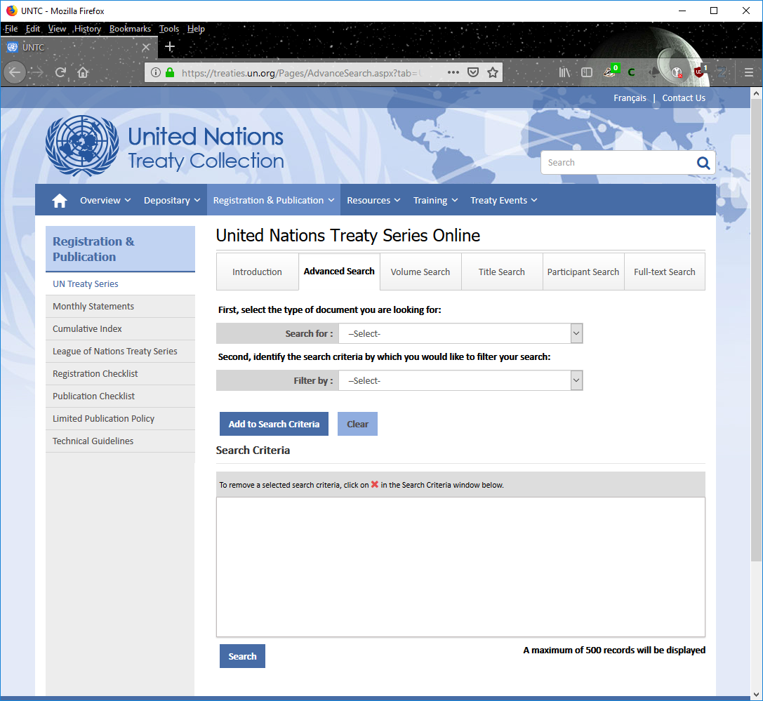
UN treaty tools
UN treaty collection
  official
  good index
  also available for LNTS

Slide 32
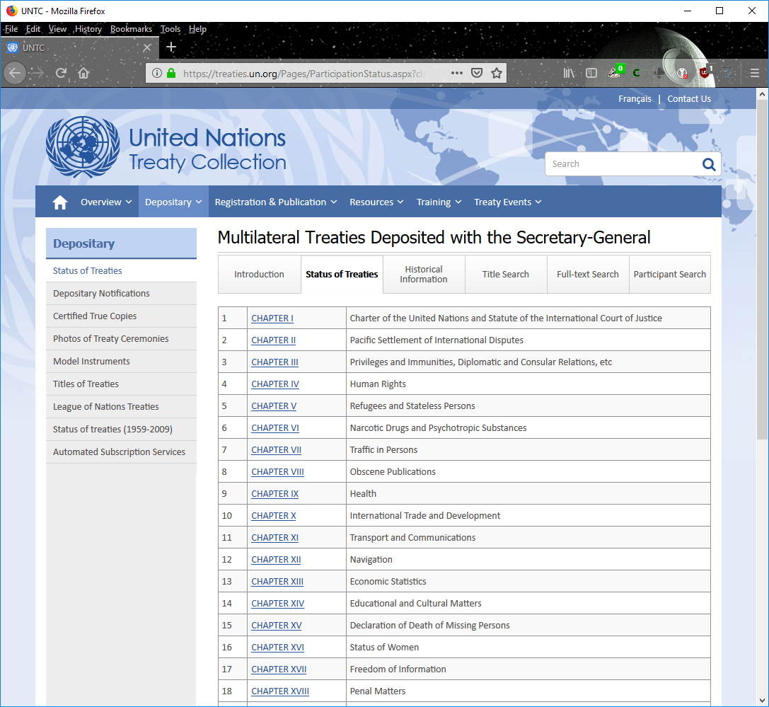
UN treaty tools
Status of Multilateral Treaties Deposited with the Secretary-General
  over 560 treaties
  includes treaties deposited with LN & some others

Slide 33
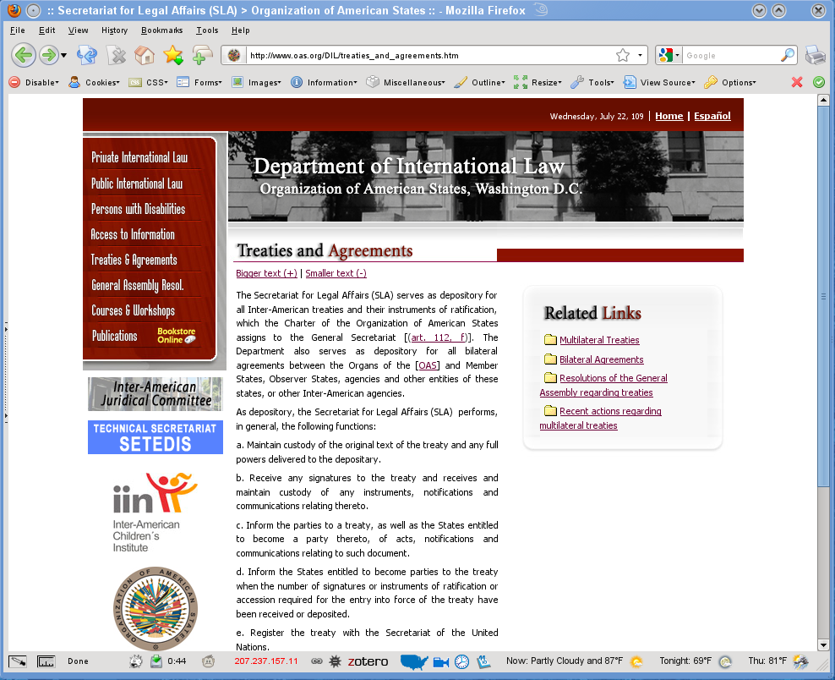
other international orgs
OAS
Council of Europe
European Union
African Union
ICRC
ILO
WTO
  all have treaty series

Slide 34
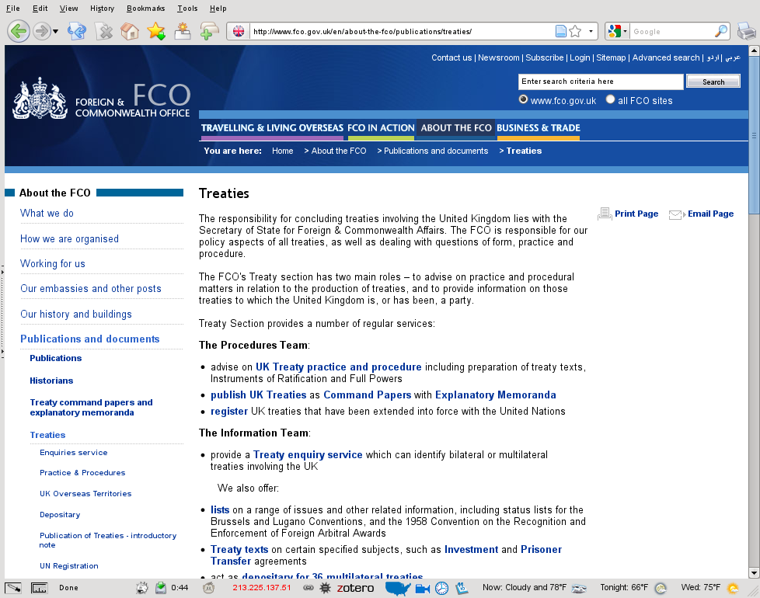
foreign state treaty sources
you usually need to read an official language, although google translate can help
UK
LegiFrance
Switzerland

Slide 35
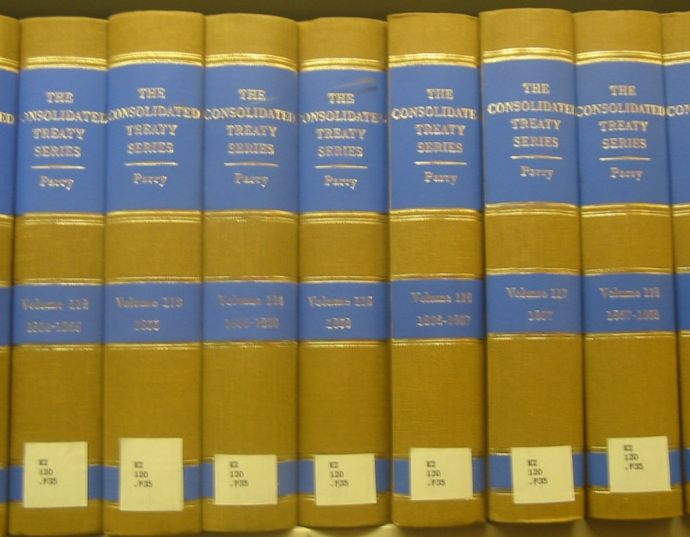
unofficial & historical sources
CTS
Avalon
USIP
Flare index
obscure print collections

Slide 36
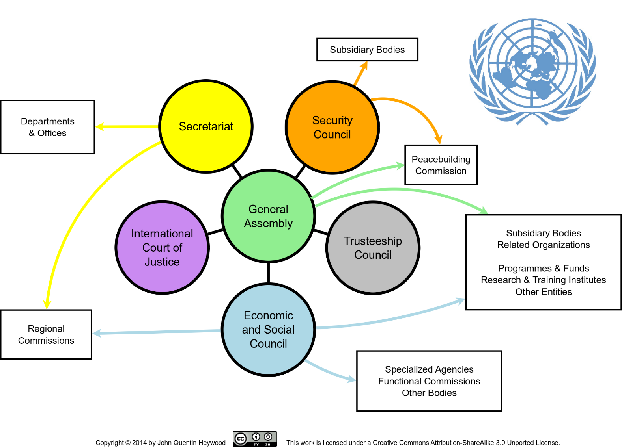
UN documents

Slide 37
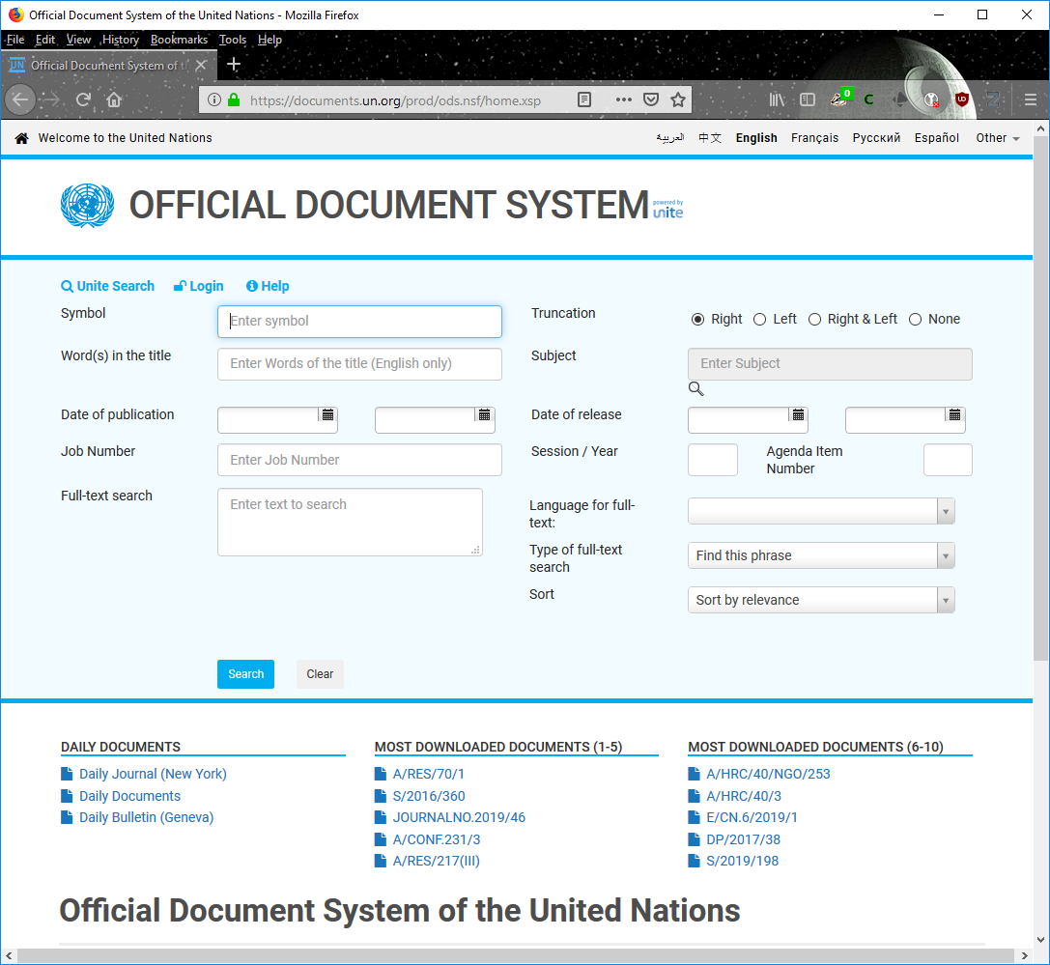
UN documents
the joy of UN docs
it is logical, just arcane
if you can’t find something quickly
ask

Slide 38
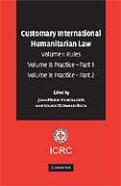
customary international law
a norm is customary:
  if derived from the general practice of states
  if followed from a sense of legal obligation, or opinio juris sive necessitatus

Slide 39
customary international law
what is “general practice”?
how many states are needed?
  general custom
  regional custom

Slide 40
customary international law
what constitutes opinio juris?
are all states bound? 2 theories:
  consuetudo
  pactum tacitum

Slide 41

customary international law
under general custom (consuetudo), you can be a persistent objector
not needed in regional custom (pactum tacitum)
but some norms you can't derogate

Slide 42

jus cogens norms
peremptory norms of general international law that cannot be derogated
treaty provisions that violate jus cogens norms are invalid

Slide 43
general principles
there are many meanings, each having a different level of acceptance
principles of municipal law applied to lacunae in international law to avoid that horror, the non-liquet
principles having their origin directly in international relations
  a continuation of the jus gentium & jus inter gentes from the Middle Ages
  primarily sovereign equality and immunity of states

Slide 44
general principles
principles recognized in all kinds of legal relations, regardless of which legal order they belong (municipal, international, int'l org, etc.), indispensable to the well-functioning of legal relations in organized societies
  pacta sunt servanda
  good faith
  etc.

Slide 45
general principles
principles of legal logic
  they determine the legal consequences resulting from two conflicting legal situations
  for example, the principle that a jus cogens norm trumps a conflicting treaty norm

Slide 46
general principles
principles of general international law
  sponsored by the USSR & other socialist countries
  right to self-determination
  right to be free of imperialist oppression
  not very well accepted at all anymore

Slide 47
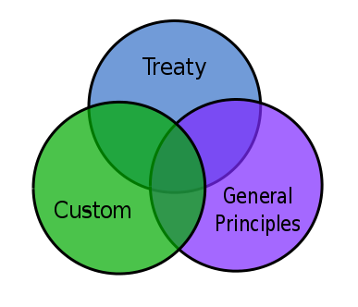
remember
a norm can be
  in a treaty
  be customary
  be a general principle
all at the same time
or not

