Slide 1
foreign law & human rights research
john quentin heywood
28 October 2020

Slide 2
links
28 October 2020
internationalcourts.net/lecturenotes
foreign law &
human rights research
<number>

Slide 3
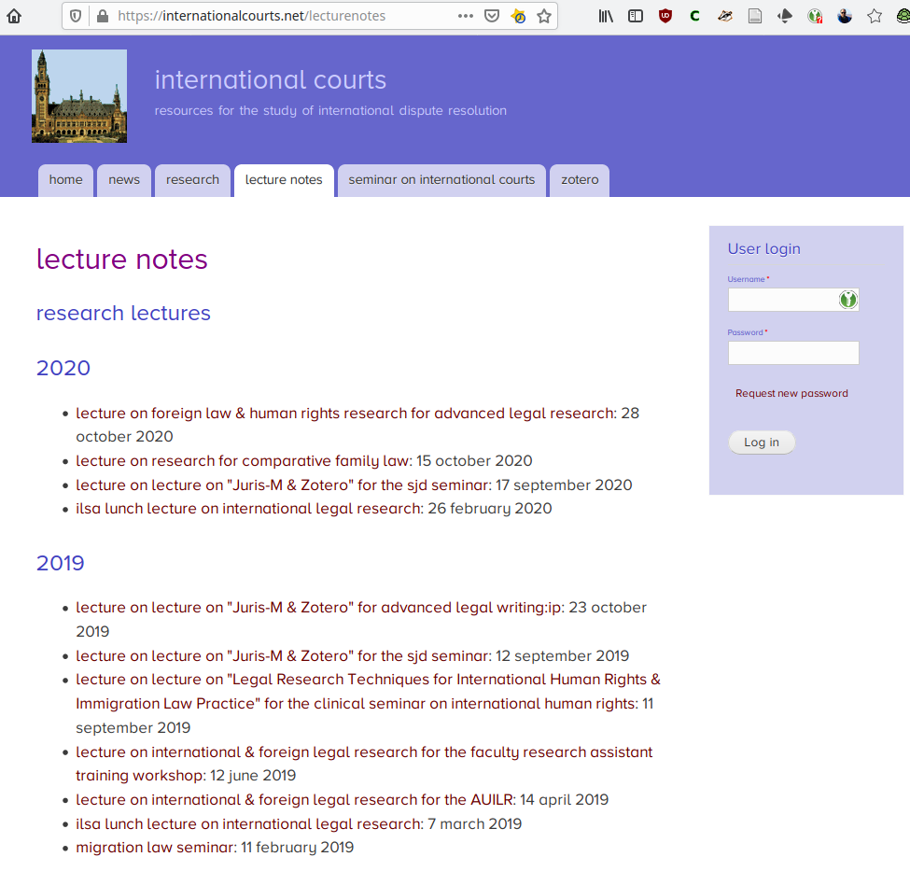
links
28 October 2020
foreign law &
human rights research
<number>

Slide 4
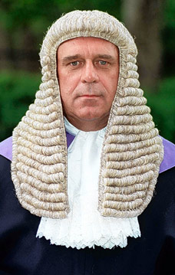
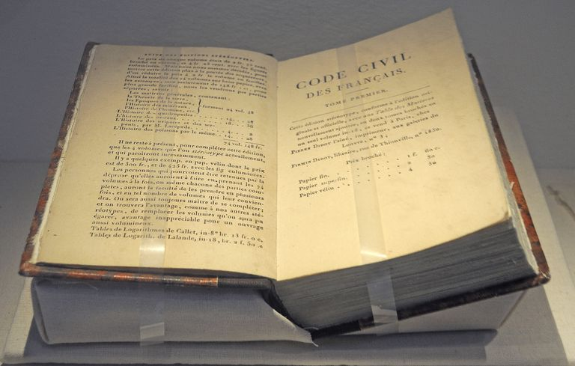
foreign law
first question to ask:
is the jurisdiction
common law?
or
civil law?
28 October 2020
foreign law &
human rights research
<number>

Slide 5
foreign law
civil law jurisdictions
sources of law include:
the basic law
the code
statutes not codified
regulations
not judicial decisions
28 October 2020
foreign law &
human rights research
<number>

Slide 6
foreign law
common law jurisdictions
sources of law include:
the basic law
statutes/codes
judicial opinions
regulations
28 October 2020
foreign law &
human rights research
<number>

Slide 7
foreign law
how do you find it?
with difficulty
note: you usually need to read one of the official languages, although google translate can help
28 October 2020
foreign law &
human rights research
<number>

Slide 8
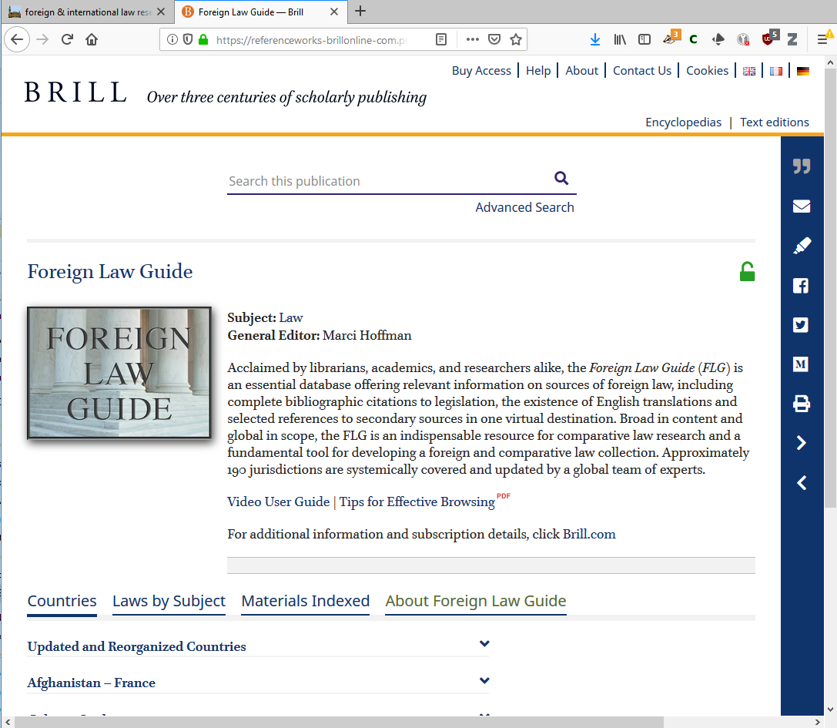
foreign law
foreign law guide
28 October 2020
foreign law &
human rights research
<number>

Slide 9
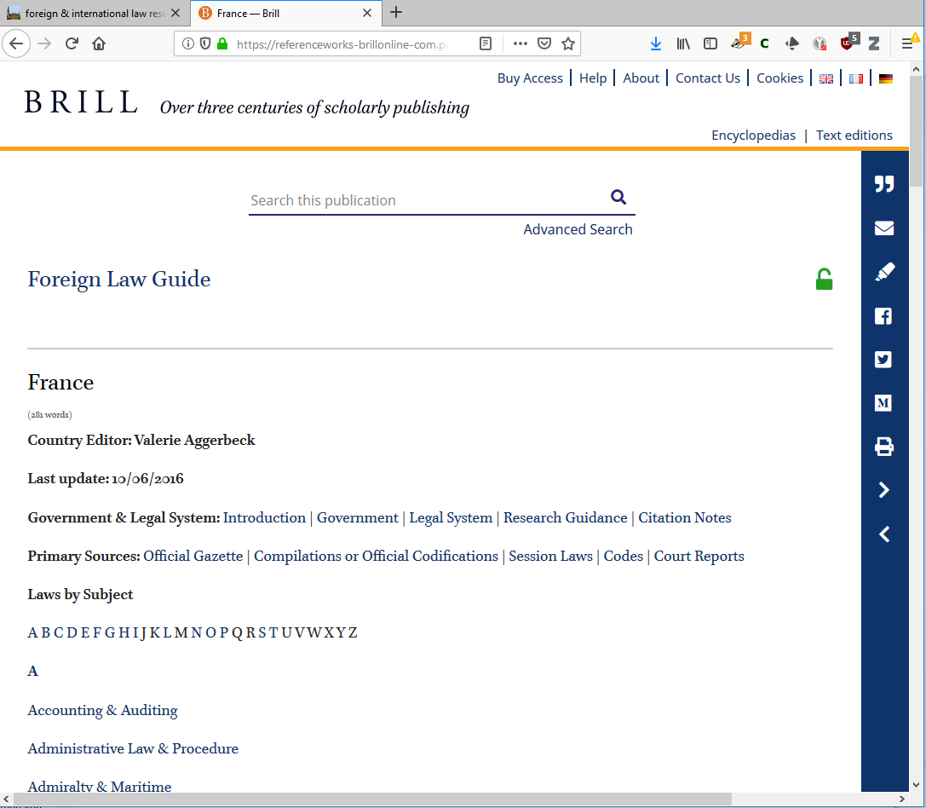
foreign law
foreign law guide
France
28 October 2020
foreign law &
human rights research
<number>

Slide 10
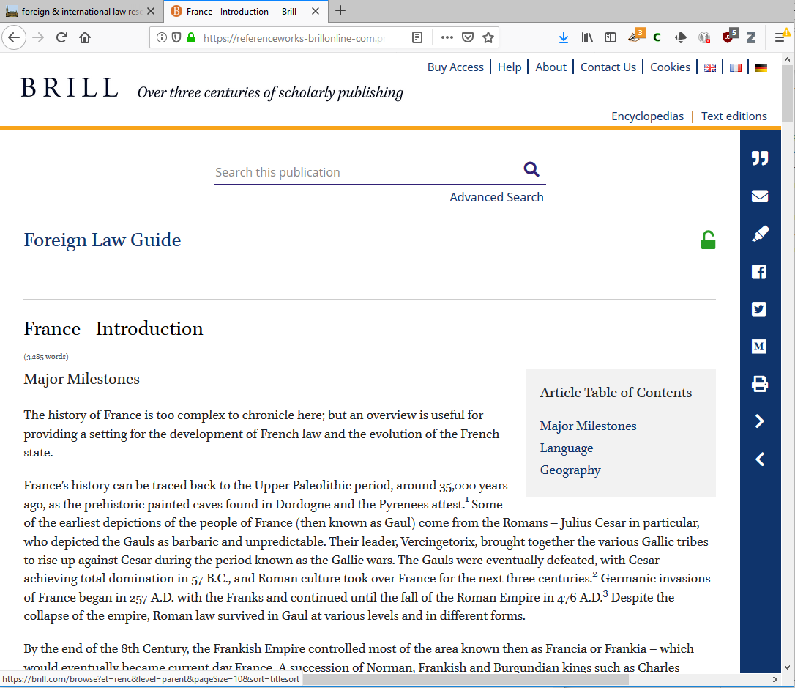
foreign law
foreign law guide
introduction
28 October 2020
foreign law &
human rights research
<number>

Slide 11
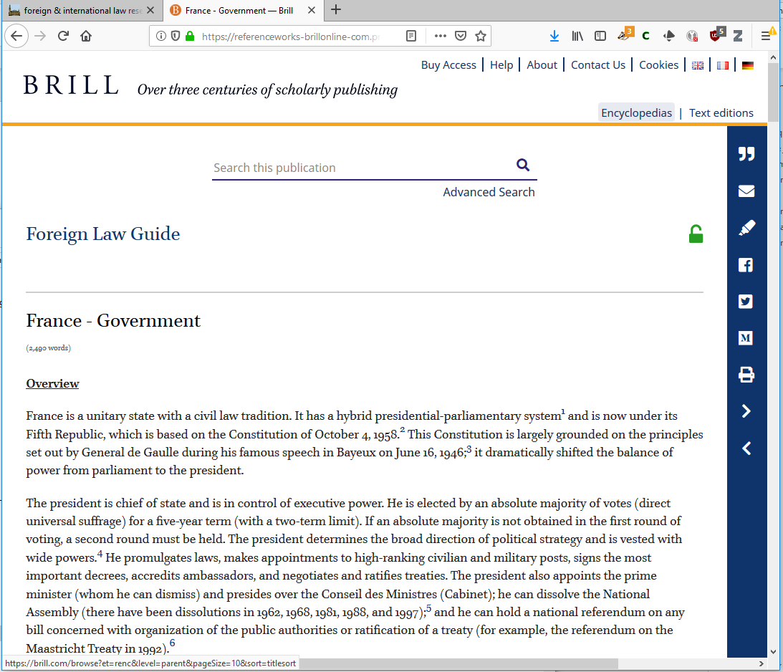
foreign law
foreign law guide
government
28 October 2020
foreign law &
human rights research
<number>

Slide 12
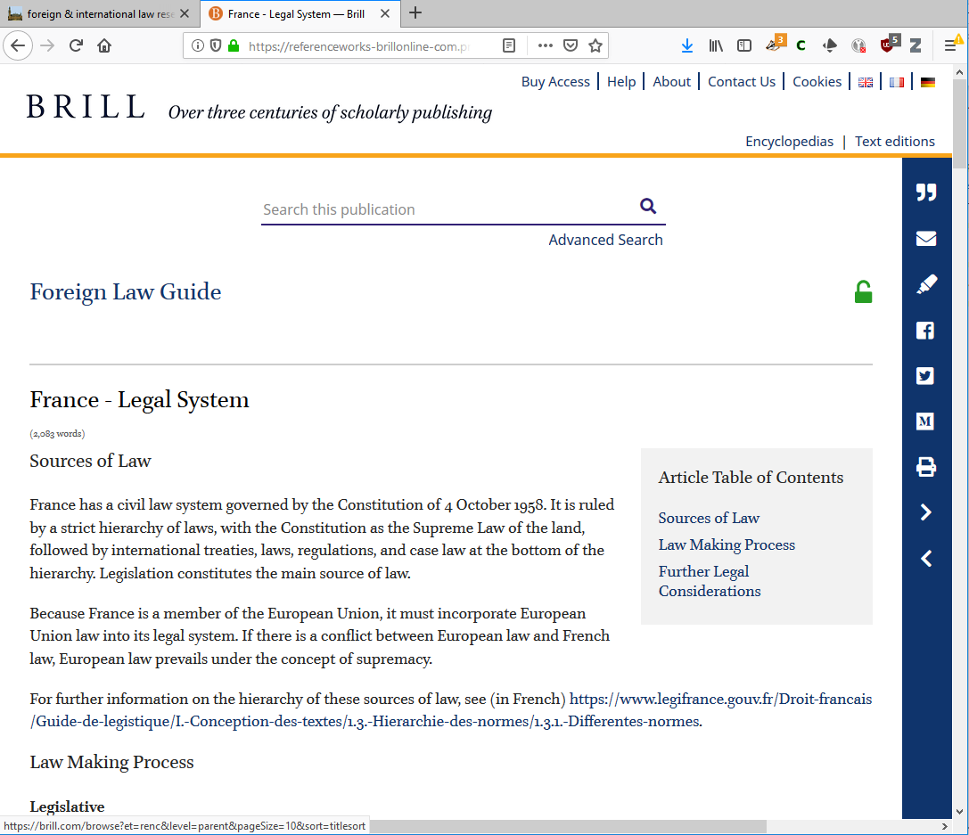
foreign law
foreign law guide
legal system
28 October 2020
foreign law &
human rights research
<number>

Slide 13
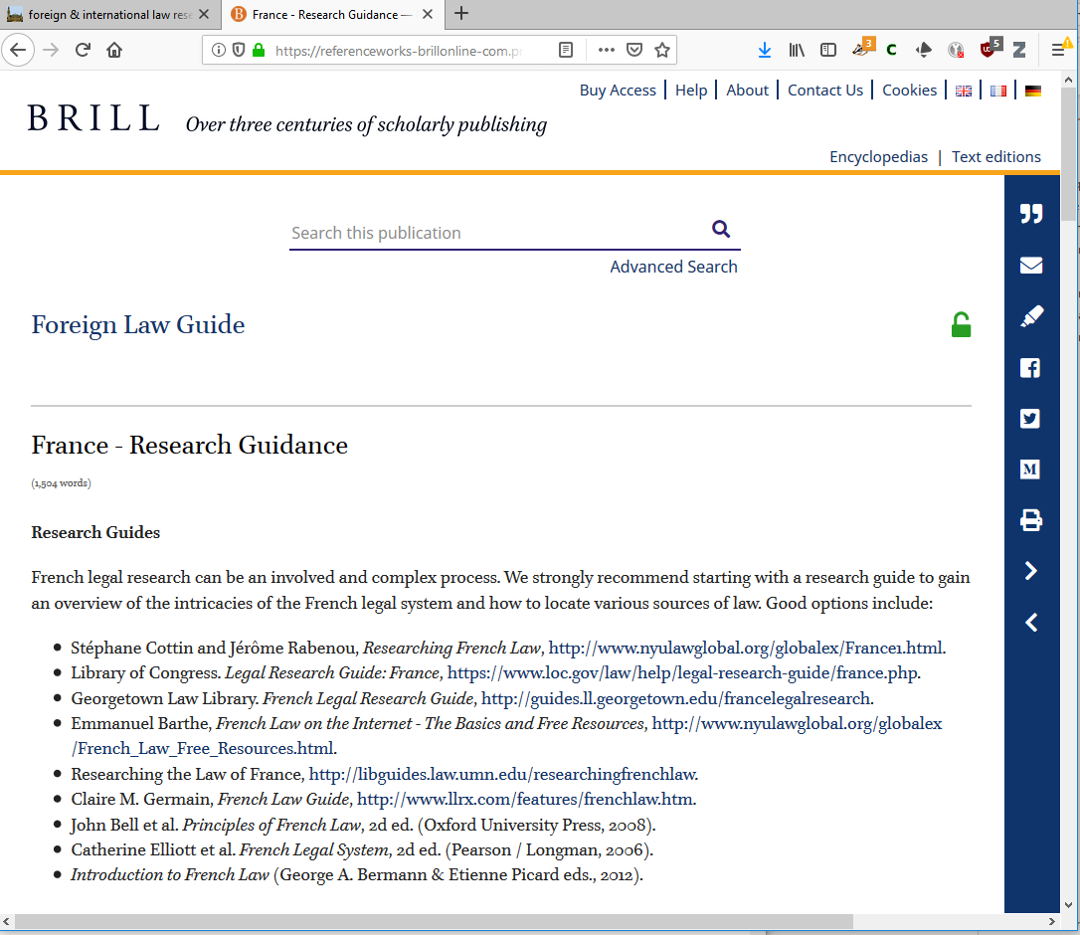
foreign law
foreign law guide
research guidance
28 October 2020
foreign law &
human rights research
<number>

Slide 14
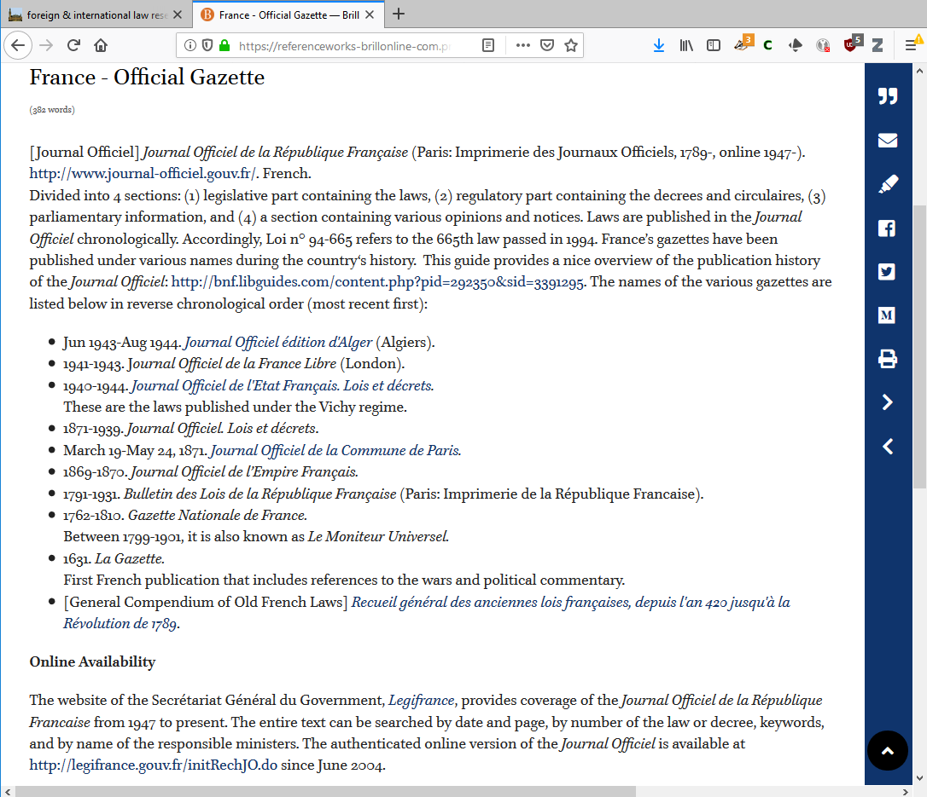
foreign law
foreign law guide
official gazette
28 October 2020
foreign law &
human rights research
<number>

Slide 15
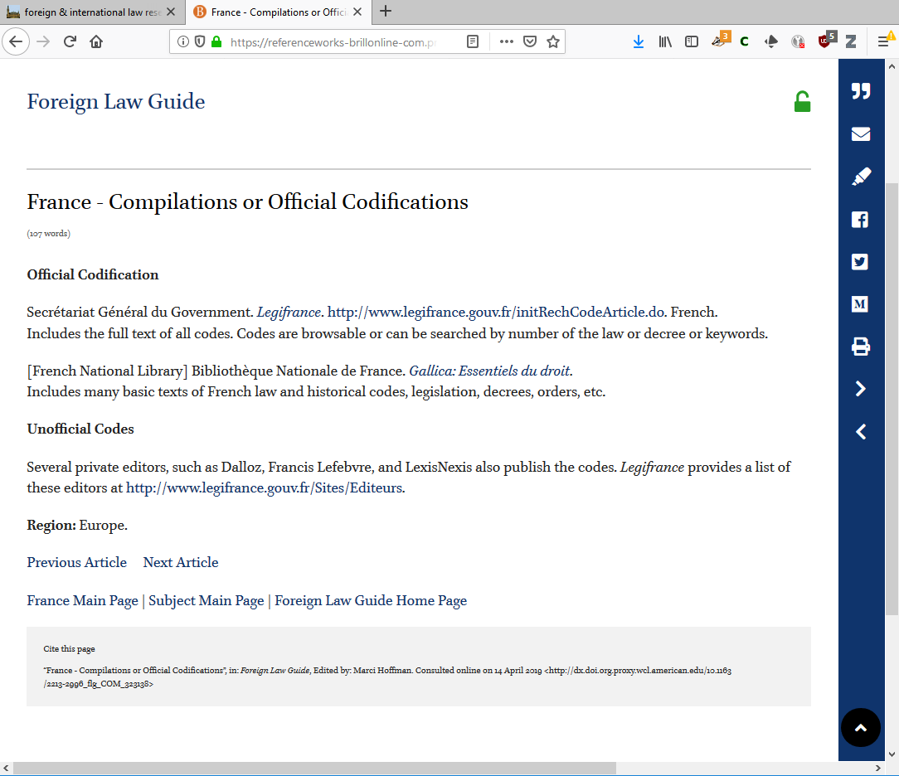
foreign law
foreign law guide
official compilations
28 October 2020
foreign law &
human rights research
<number>

Slide 16
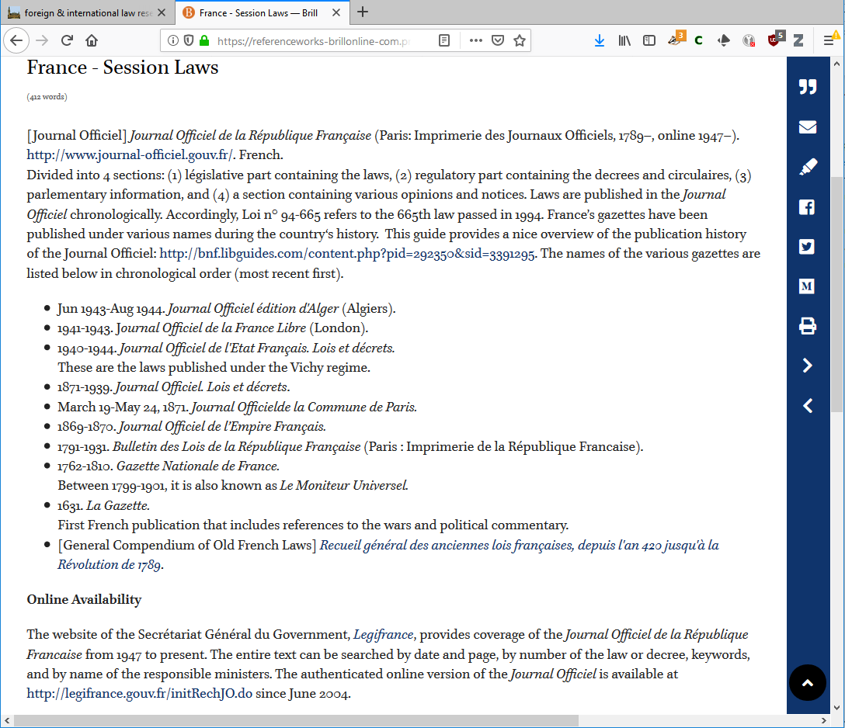
foreign law
foreign law guide
session laws
28 October 2020
foreign law &
human rights research
<number>

Slide 17
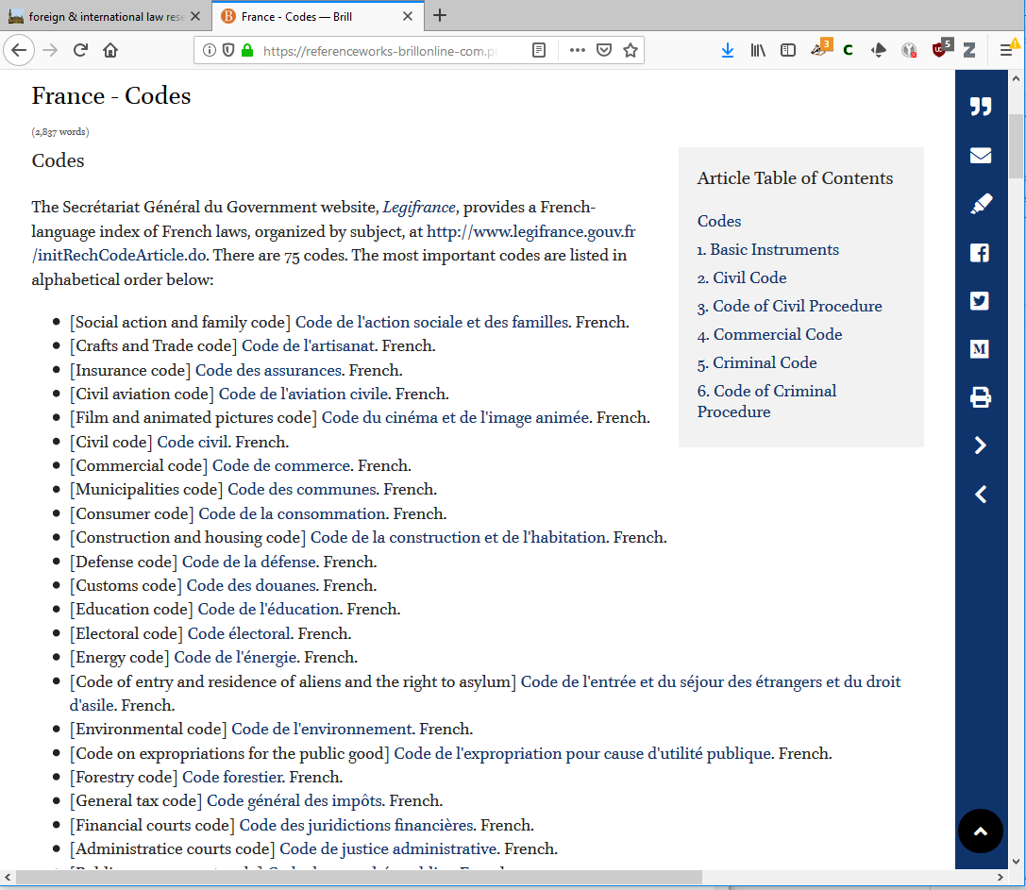
foreign law
foreign law guide
codes
28 October 2020
foreign law &
human rights research
<number>

Slide 18
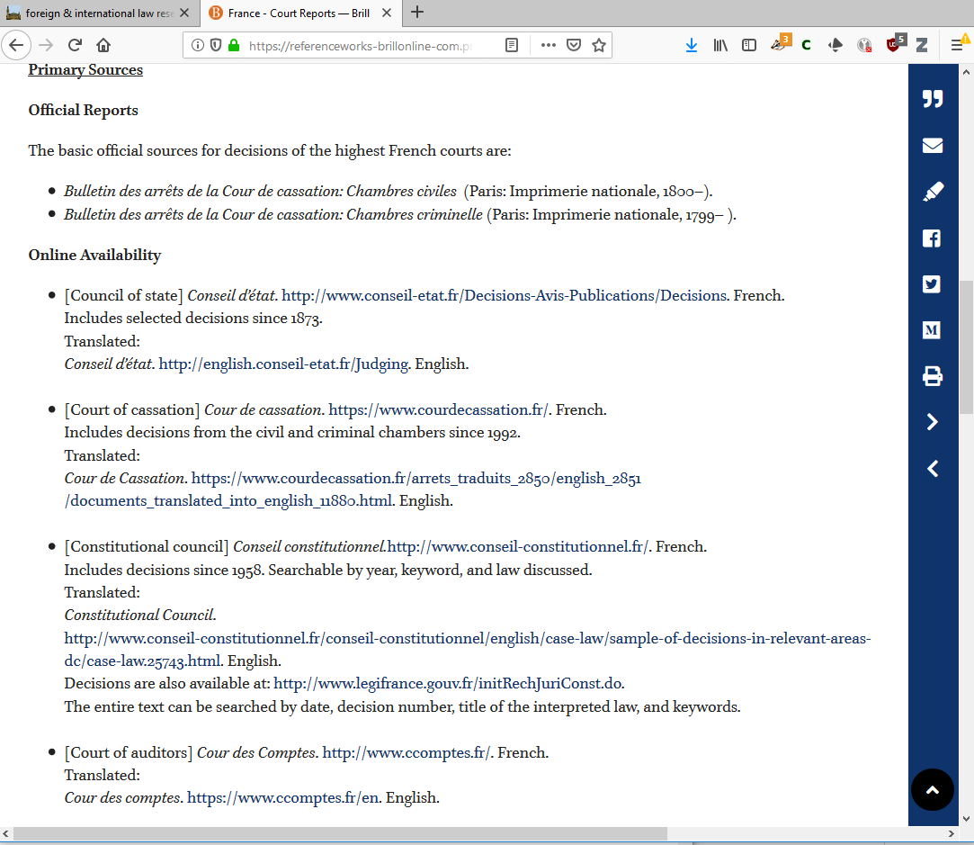
foreign law
foreign law guide
court decisions
28 October 2020
foreign law &
human rights research
<number>

Slide 19
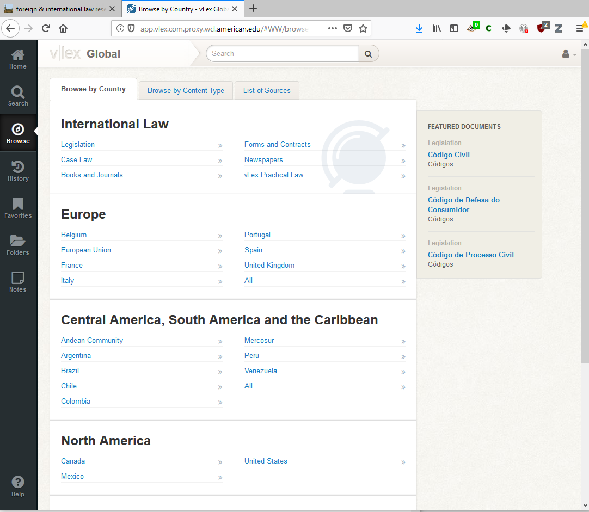
foreign law
vLex
28 October 2020
foreign law &
human rights research
<number>

Slide 20
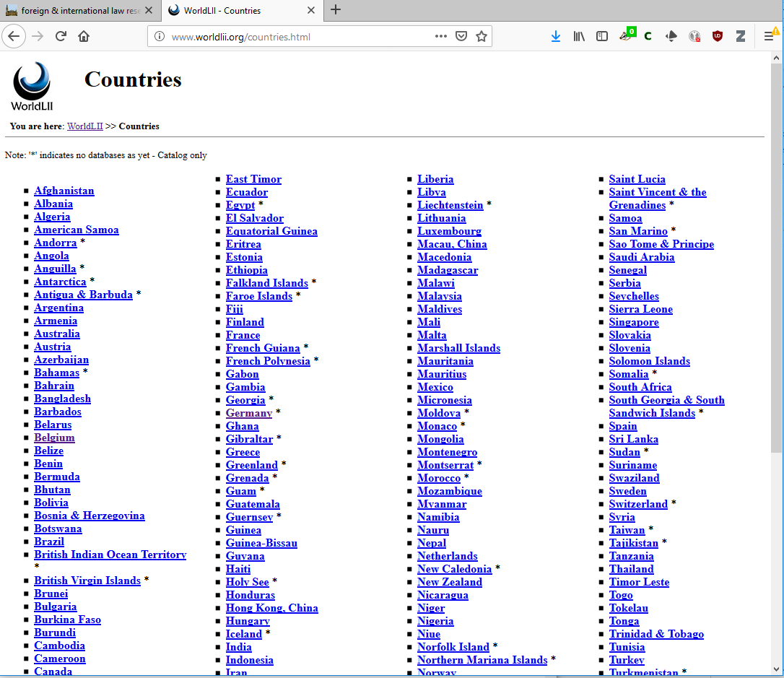
foreign law
WorldLII
28 October 2020
foreign law &
human rights research
<number>

Slide 21
human rights
general international organizations
regional international organizations
international criminal courts/tribunals
28 October 2020
foreign law &
human rights research
<number>

Slide 22
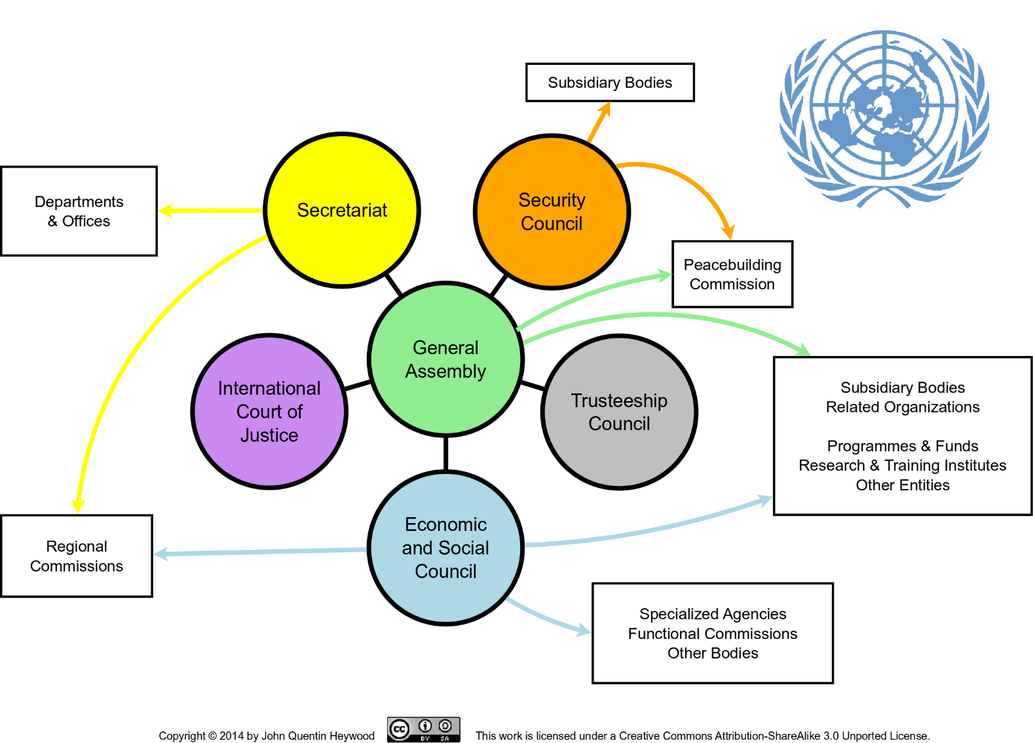
UN documents
28 October 2020
foreign law &
human rights research
<number>

Slide 23
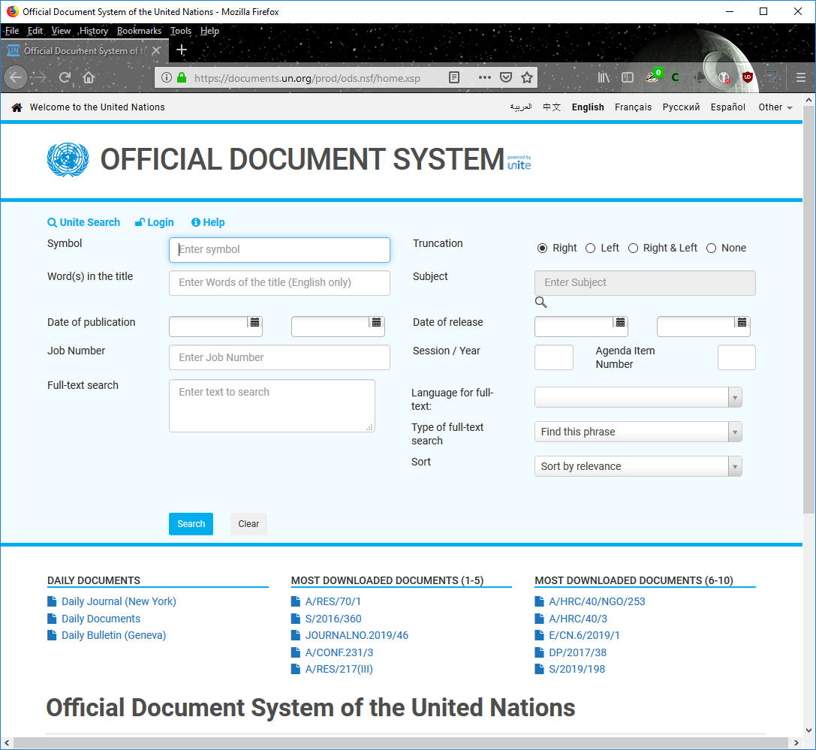
UN documents
the joy of UN docs
it is logical, just arcane
if you can’t find something quickly
ask
28 October 2020
foreign law &
human rights research
<number>

Slide 24
human rights general international organizations
28 October 2020
UN High Commissioner for Refugees (UNHCR)
UN Office of the High Commissioner for Human Rights (OHCHR)
International Labour Organization (ILO)
foreign law &
human rights research
<number>

Slide 25
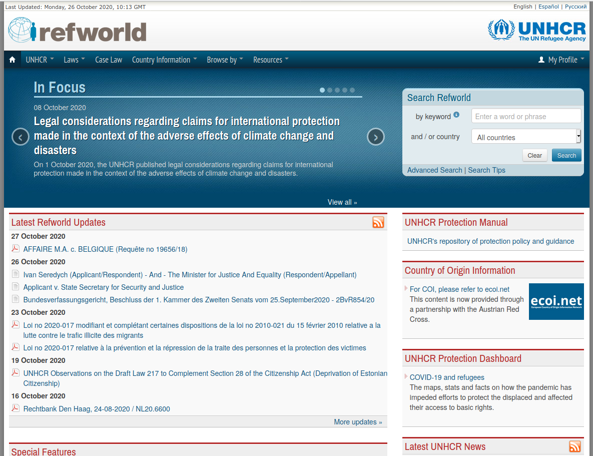
28 October 2020
foreign law &
human rights research
<number>

Slide 26
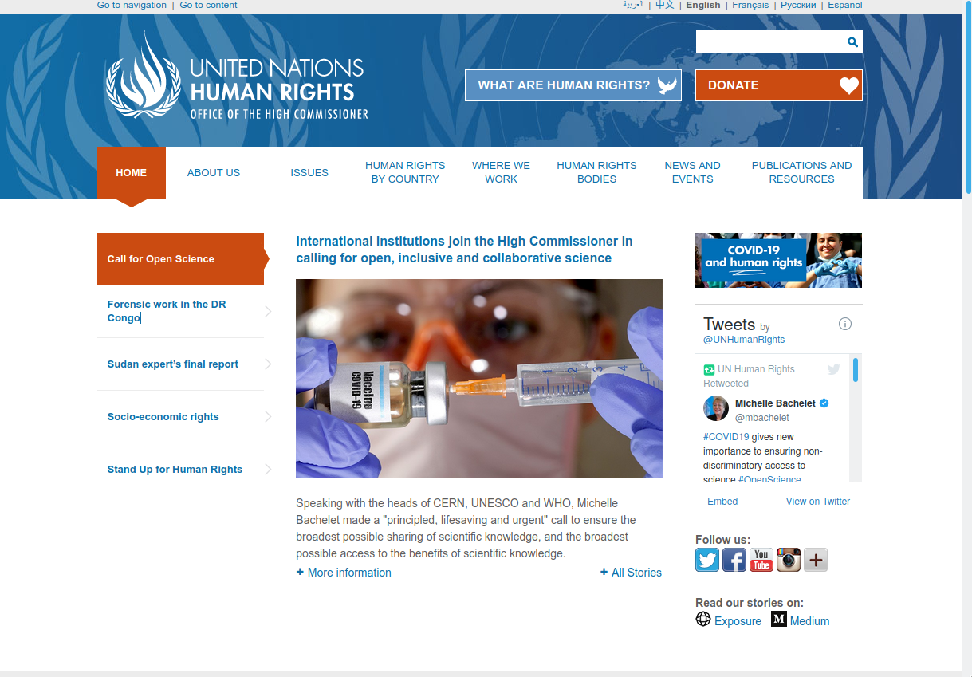
28 October 2020
foreign law &
human rights research
<number>

Slide 27
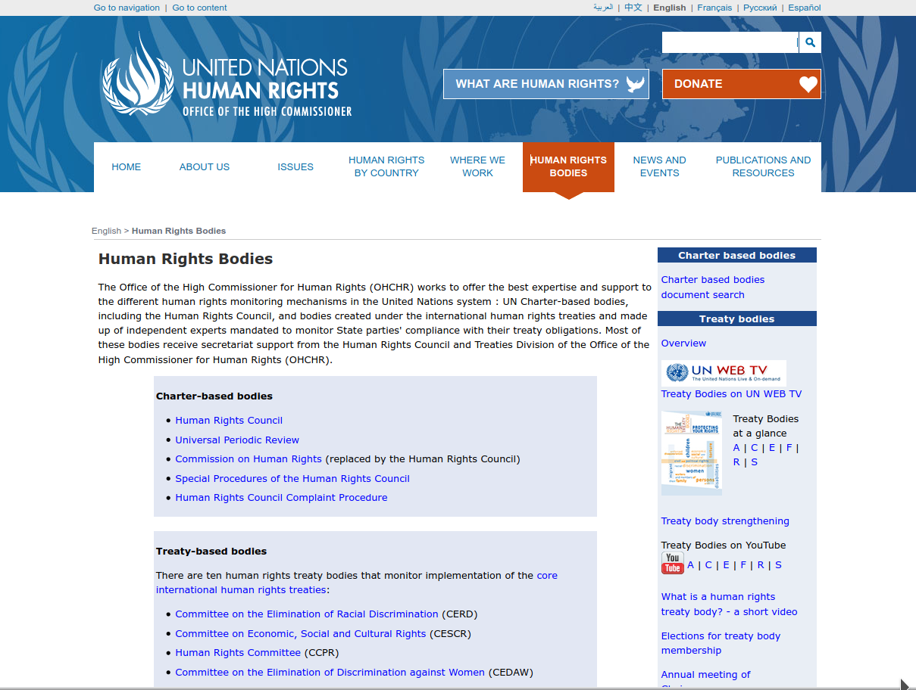
28 October 2020
foreign law &
human rights research
<number>

Slide 28
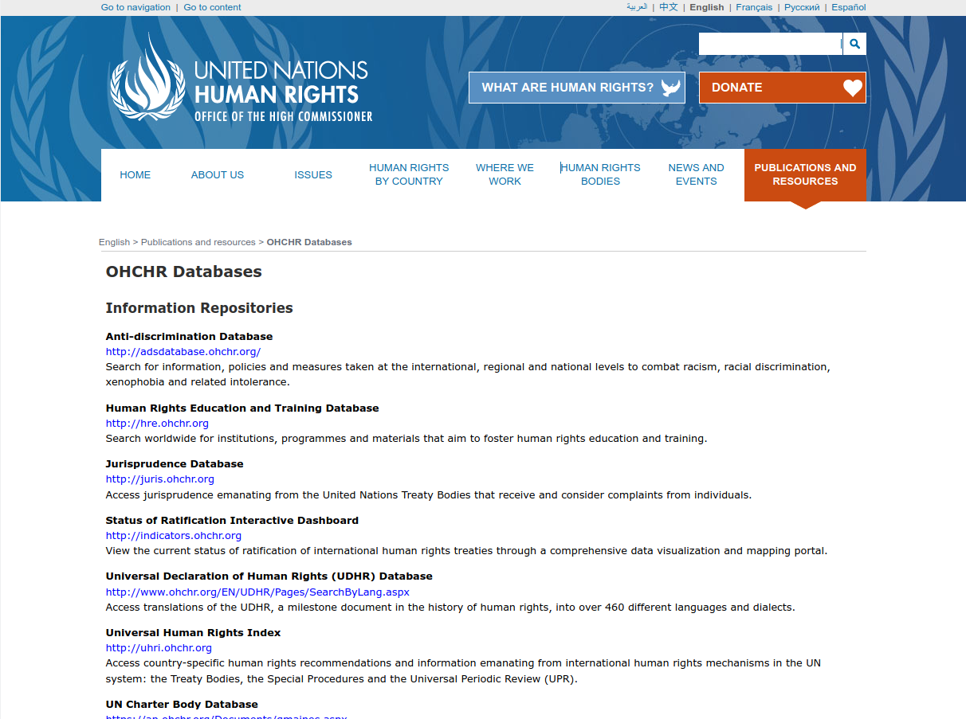
28 October 2020
foreign law &
human rights research
<number>

Slide 29
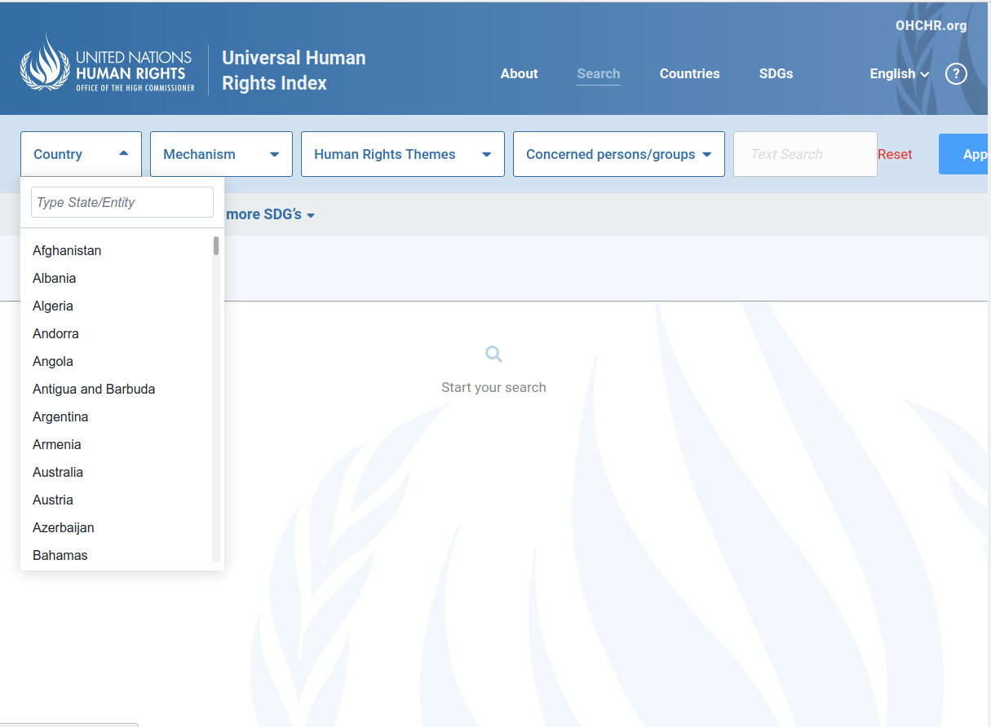
28 October 2020
foreign law &
human rights research
<number>

Slide 30
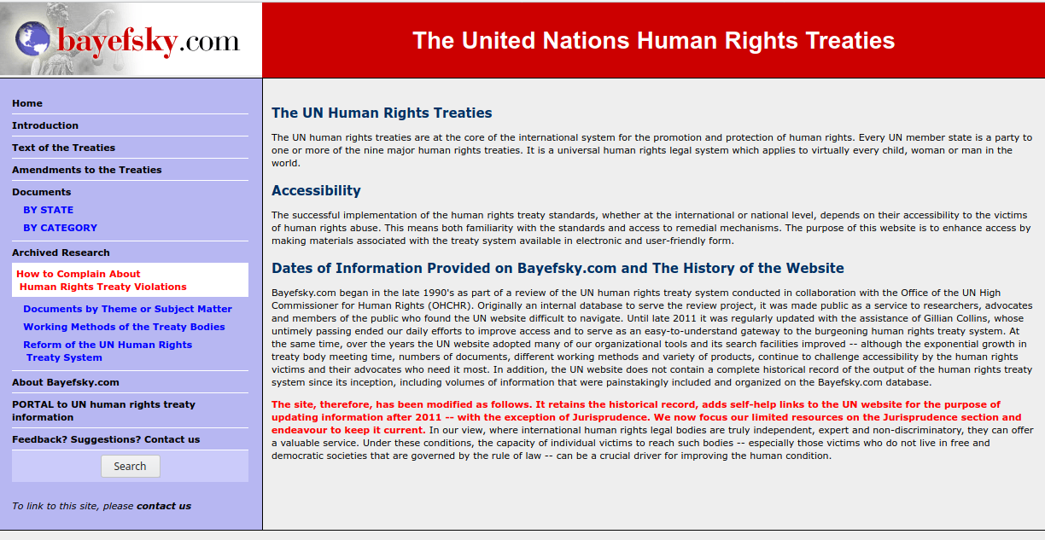
28 October 2020
foreign law &
human rights research
<number>

Slide 31
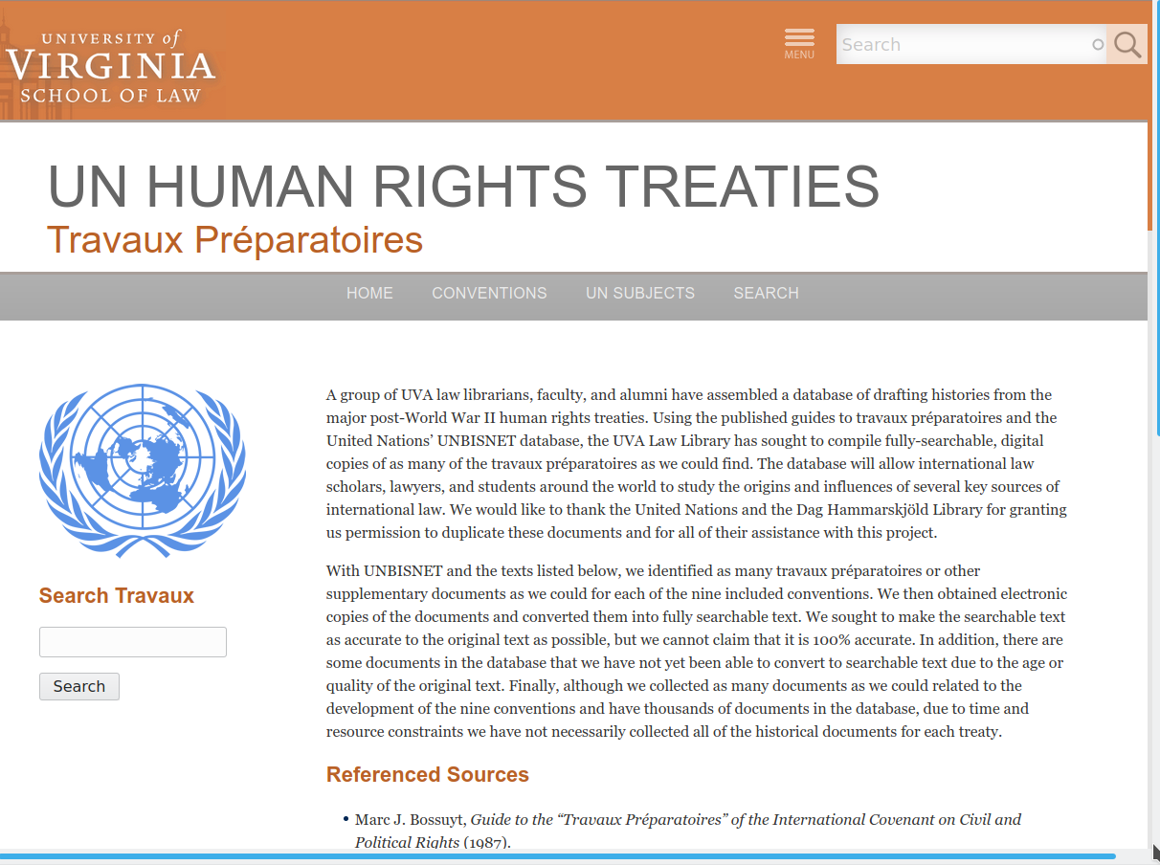
28 October 2020
foreign law &
human rights research
<number>

Slide 32
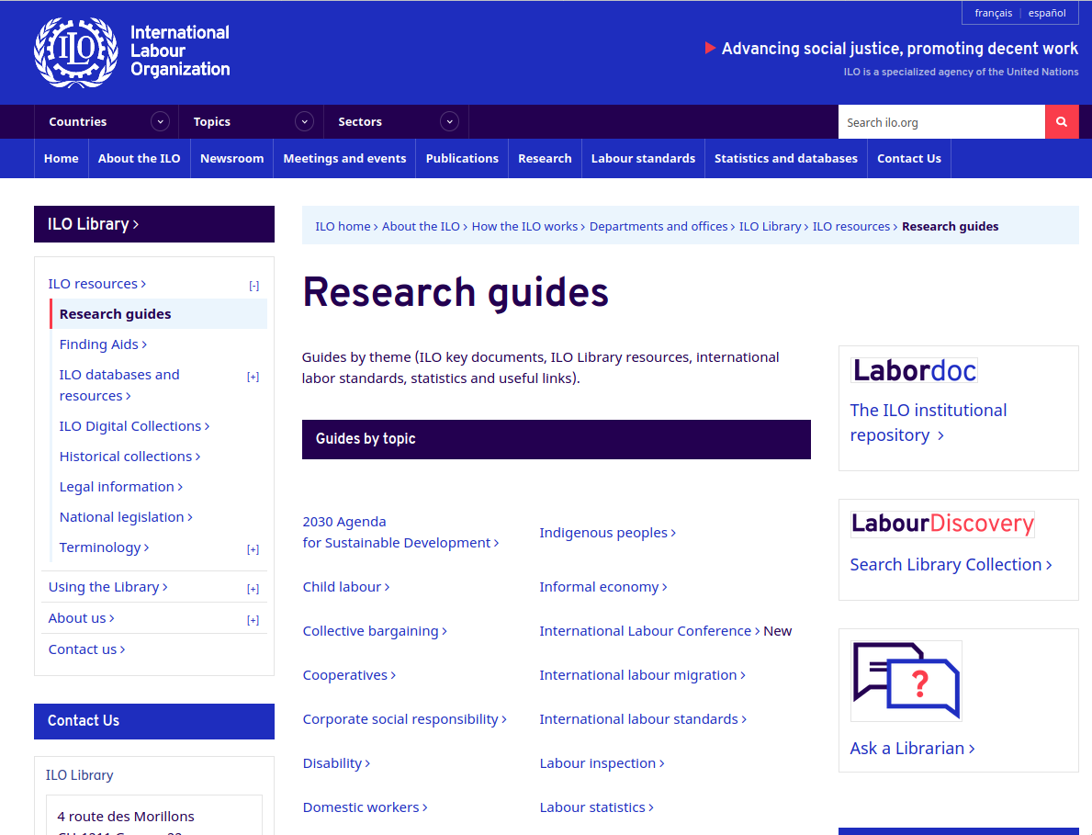
28 October 2020
foreign law &
human rights research
<number>

Slide 33
human rights regional international organizations
28 October 2020
Council of Europe
European Union
Organization of American States
African Union
foreign law &
human rights research
<number>

Slide 34
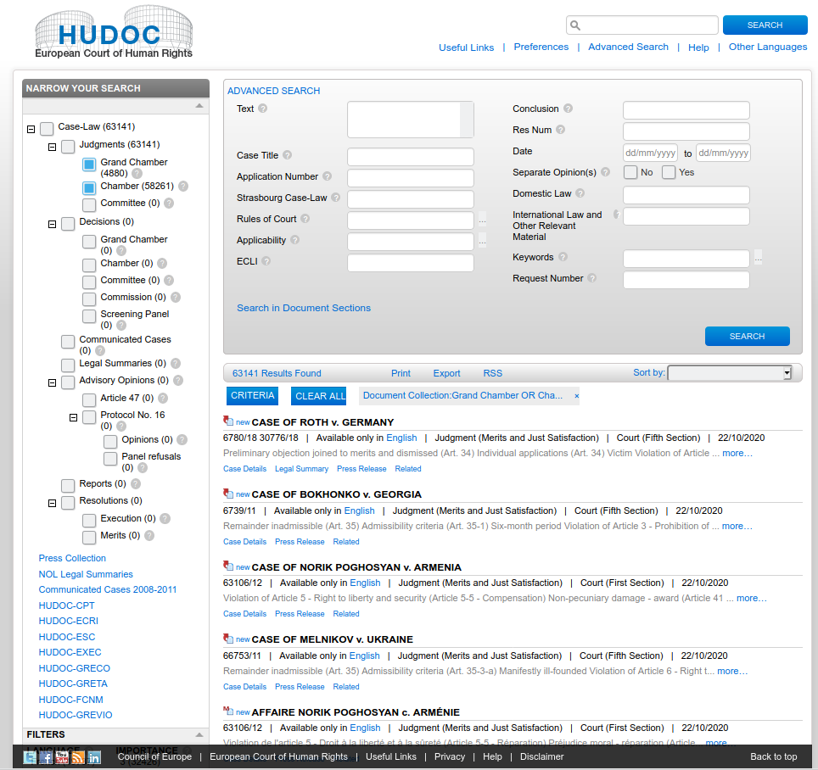
28 October 2020
foreign law &
human rights research
<number>

Slide 35
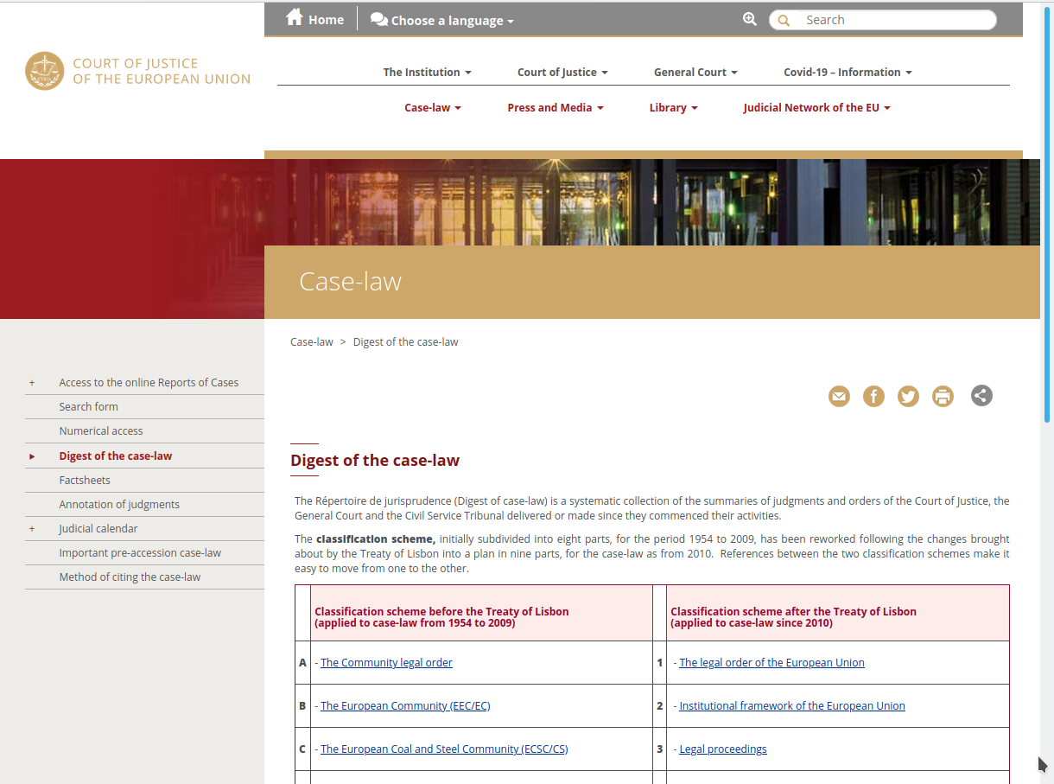
28 October 2020
foreign law &
human rights research
<number>

Slide 36
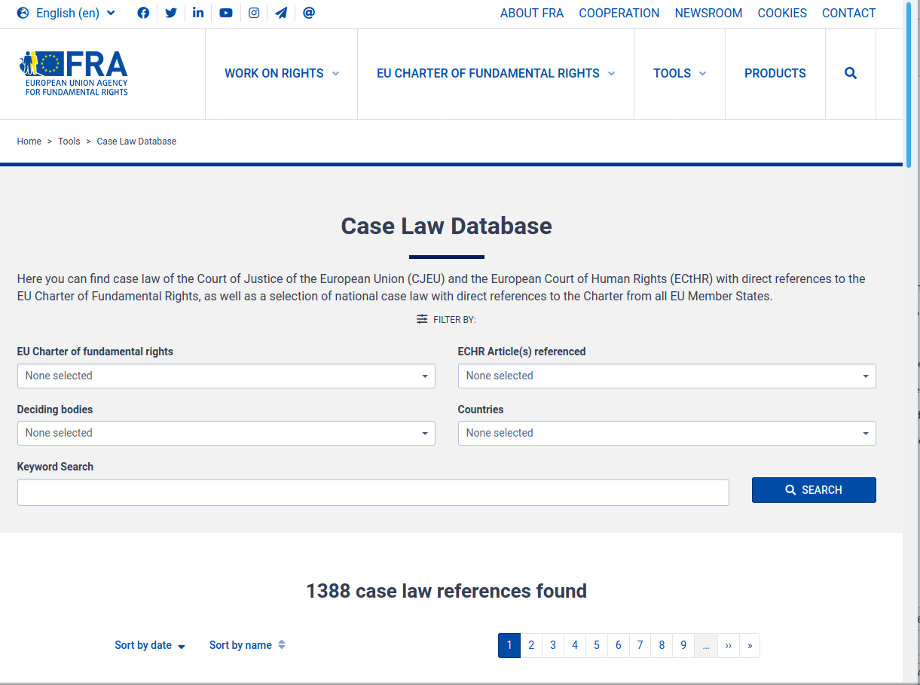
28 October 2020
foreign law &
human rights research
<number>

Slide 37
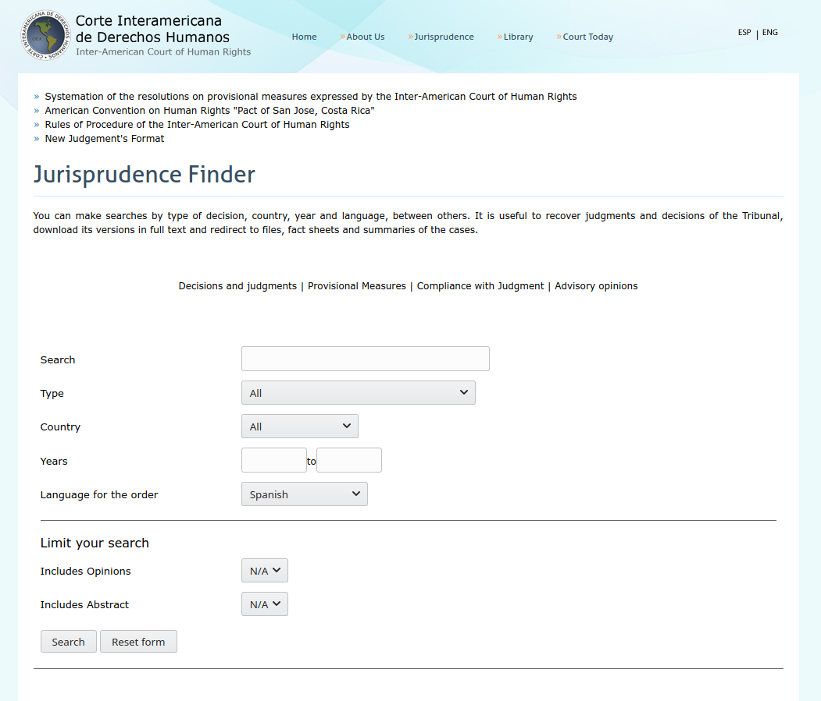
28 October 2020
foreign law &
human rights research
<number>

Slide 38
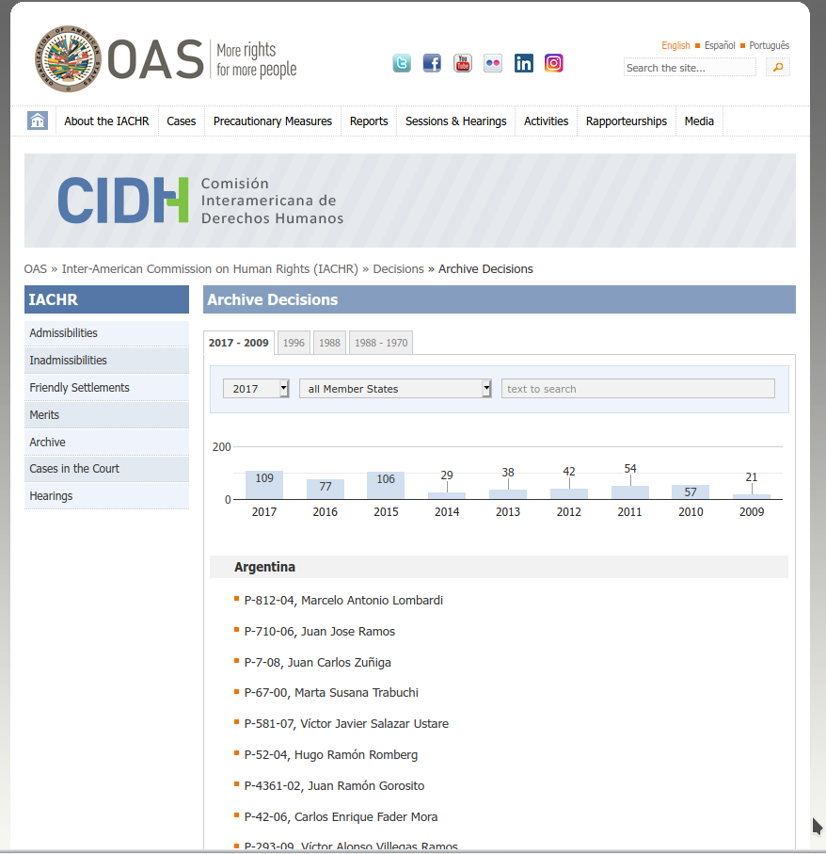
28 October 2020
foreign law &
human rights research
<number>

Slide 39
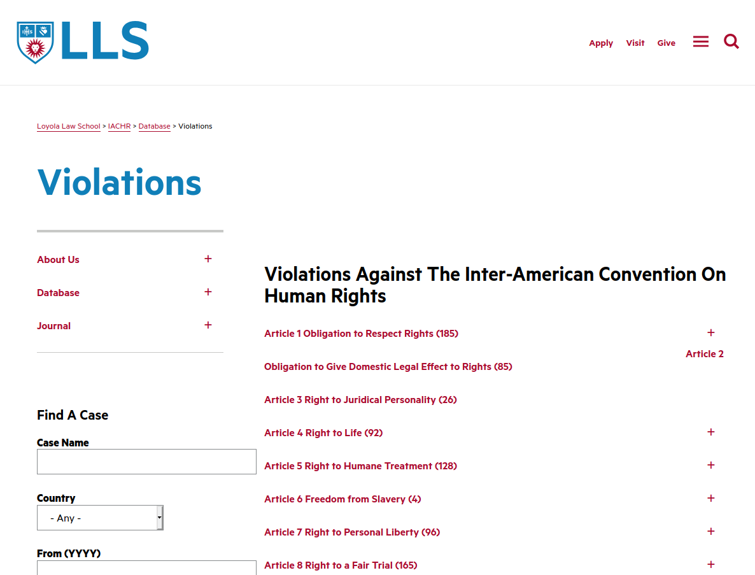
28 October 2020
foreign law &
human rights research
<number>

Slide 40
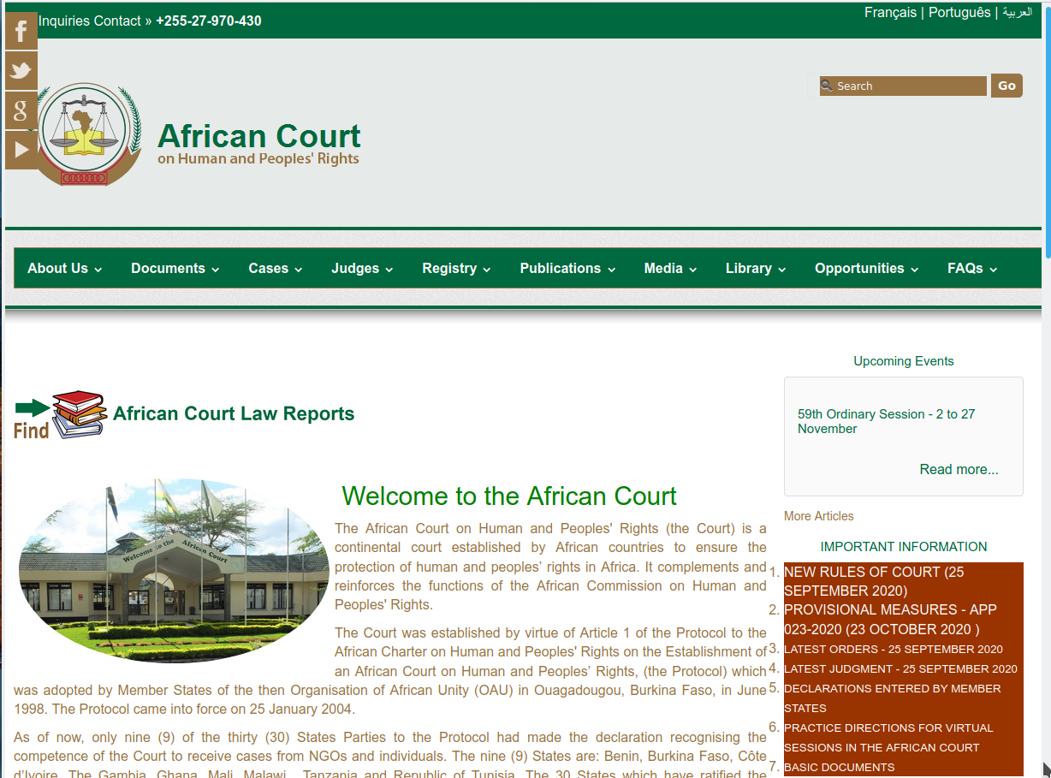
28 October 2020
foreign law &
human rights research
<number>

Slide 41
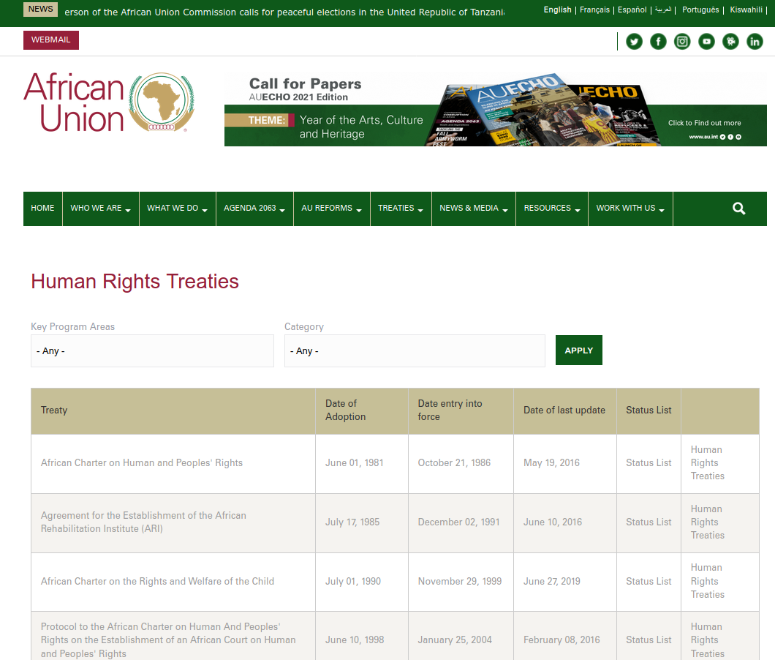
28 October 2020
foreign law &
human rights research
<number>

Slide 42
human rights international criminal courts/tribunals
28 October 2020
International Criminal Court
International Residual Mechanism for Criminal Tribunals (ICTY & ICTR)
Special Tribunal for Lebanon
Special Court for Sierra Leone
Extraordinary Chambers (Cambodia)
Special Panels (East Timor)
International Military Tribunal (Nuremburg) & International Military Tribunal for the Far East
foreign law &
human rights research
<number>

Slide 43
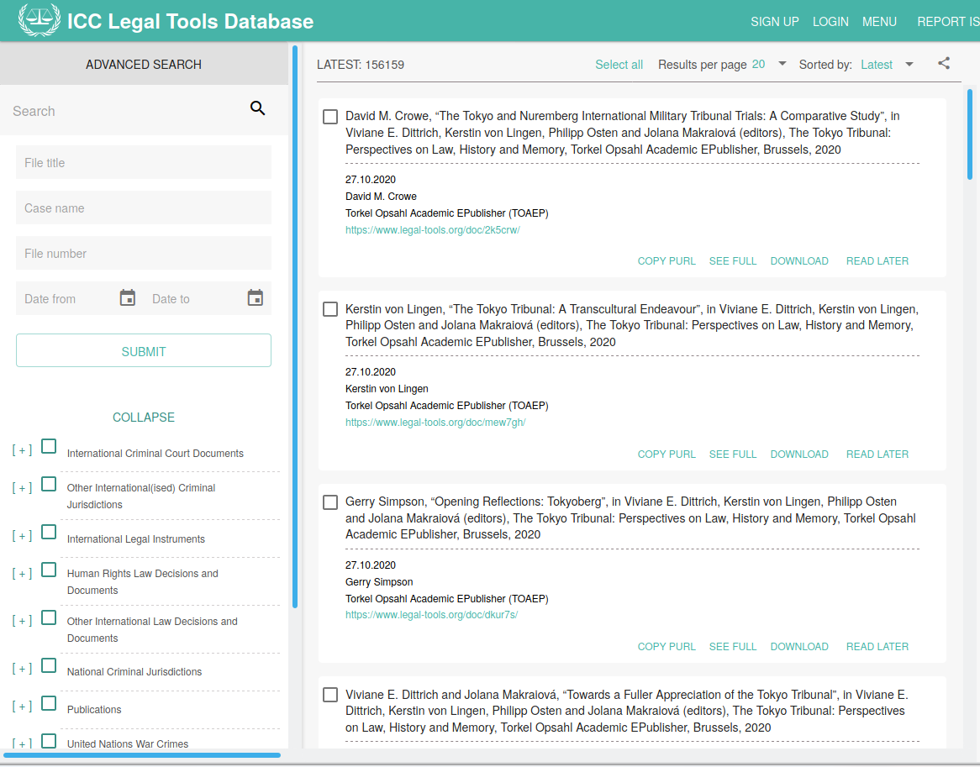
28 October 2020
foreign law &
human rights research
<number>

Slide 44
finally . . . ask us for help
bill ryan
wryan@wcl.american.edu
202-274-4331
room N219
28 October 2020
foreign law &
human rights research
<number>

Slide 45
finally . . . ask us for help
john heywood
heywood@wcl.american.edu
202-274-4329
room N216 (someday)
28 October 2020
foreign law &
human rights research
<number>

